Slide 1
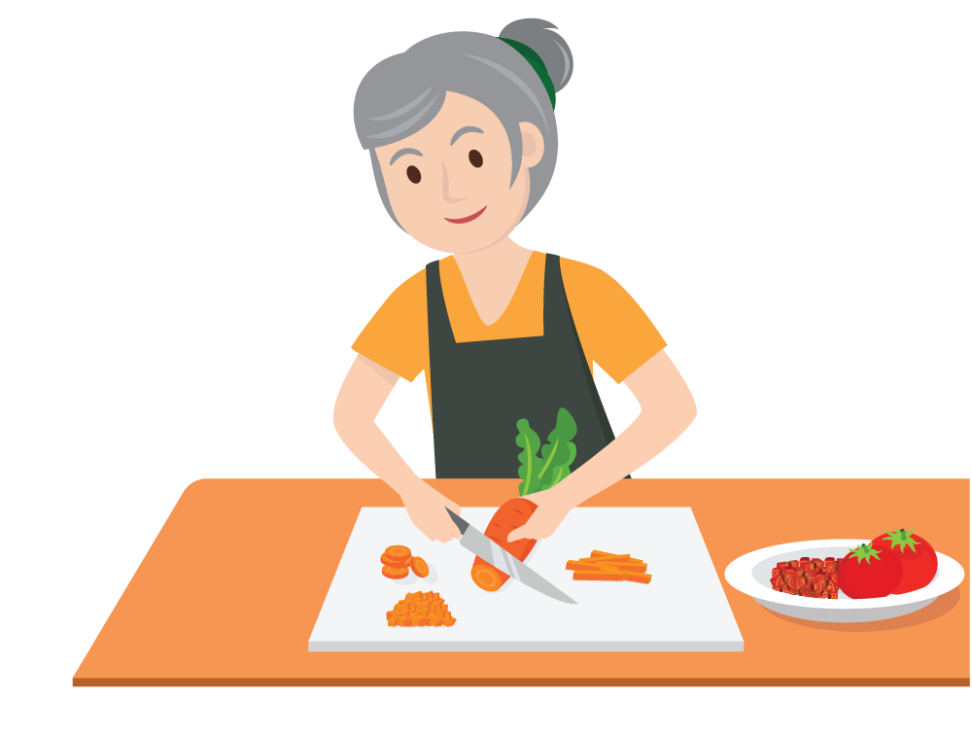
Serving Vegetables in the CACFP
A Training Presentation for
Child and Adult Care Food
Program (CACFP) Operators

Slide 2


USDA’s Team Nutrition
An initiative of the USDA’s Food and Nutrition Service to support the USDA’s Child Nutrition Programs.
Aims to improve children’s lifelong eating and physical activity habits.
Provides nutrition education and training materials to State agencies, sponsoring organizations, and CACFP sites.
fns.usda.gov/teamnutrition
Notes:
Team Nutrition is an initiative of the USDA Food and Nutrition Service that supports the Child Nutrition Programs, including the National School Lunch Program, the School Breakfast Program, and of course, the Child and Adult Care Food Program, or the CACFP.
It does so through training and technical assistance for those preparing and serving meals, providing nutrition education for children, and building support for healthier school and child care environments.

Slide 3
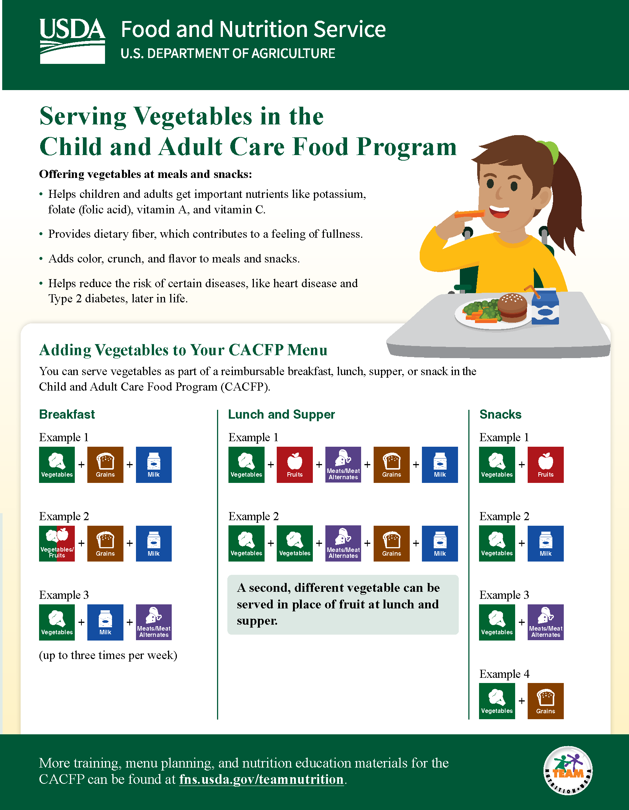
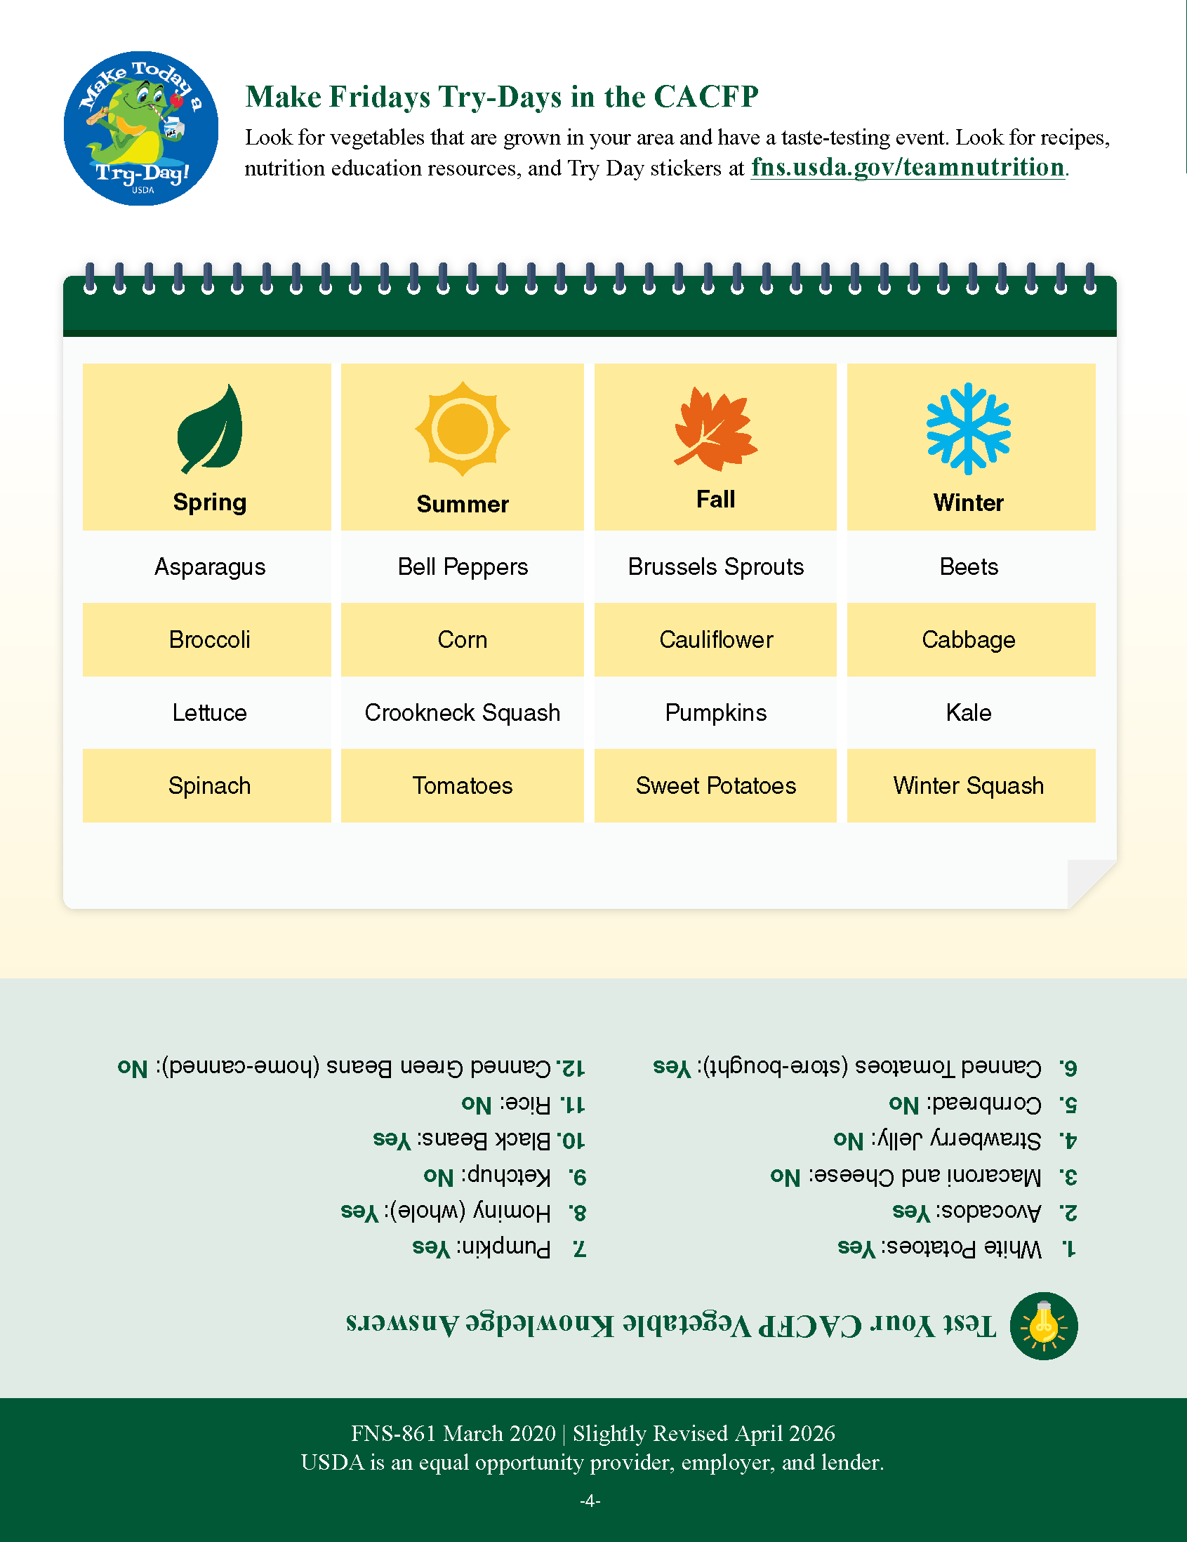

Serving Vegetables in the CACFP
fns.usda.gov/teamnutrition
Notes:
I hope everyone has had an opportunity to obtain the digital version of the worksheet. If you were unable to download a digital copy before the start of the webinar, you can do so now by scanning the QR code on your screen. If you cannot obtain a digital copy of the worksheet, please follow along using the images on the screen.
Now, we will talk about different ways to serve vegetables at breakfast, lunch, supper and snack in the CACFP.

Slide 4
Offering Vegetables at Meals and Snacks
Serving Vegetables in the Child and Adult Care Food Program
Offering vegetables at meals and snacks:
Helps children and adults get important nutrients like potassium, folate (folic acid), vitamin A, and vitamin C.
Provides dietary fiber, which contributes to a feeling of fullness.
Adds color, crunch, and flavor to meals and snacks.
Helps reduce the risk of certain diseases, like heart disease and Type 2 diabetes, later in life.
Notes:
Vegetables are an essential part of a healthy eating pattern. Vegetables are nutrient‑dense foods that support growth, immunity, and long‑term health for people of all ages. Adding a variety of vegetables to meals and snacks adds color, texture, and flavor while helping children and adults meet their daily nutrition needs.

Slide 5
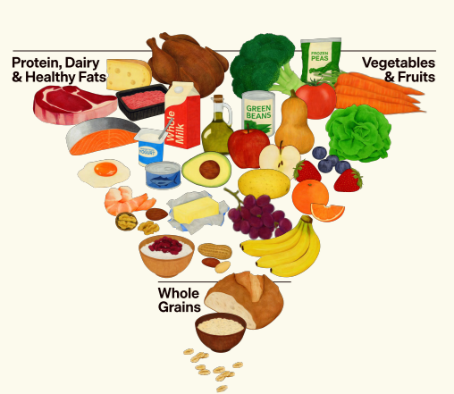
The Real Food Pyramid
https://realfood.gov/
Notes:
When planning your CACFP menus, follow the Dietary Guideline for Americans and the Real Food Pyramids’ recommendations which include selecting whole vegetables in their original form, when possible, choosing frozen, dried, or canned vegetables with no or very limited added sugars, and if desired, add flavor by seasoning vegetables with spices and herbs.
For more information about the Dietary Guidelines and the Real Food Pyramid go to the web address shown on the slide, https://realfood.gov/.

Slide 6
How CACFP Vegetable Requirements Support the Real Food Pyramid and Dietary Guidelines
Dietary Guidelines for Americans | CACFP Vegetable Requirements
Recommends a variety of vegetables | Requires vegetables at lunch/supper and provides the opportunity to serve vegetables at breakfasts and snack
Encourages nutrient-dense, whole foods | Crediting regulations prioritize whole vegetables
Recommends limiting juice | Allows juice only once per day
Promotes fiber rich foods | Many vegetables are high in fiber
Notes:
On this slide, you can see how the CACFP vegetable requirements align with the Dietary Guidelines for Americans. Offering vegetables at multiple meals gives Program operators more chances to serve a wider variety of vegetables. This helps participants explore different flavors and textures and ensures they receive a range of essential nutrients.

Slide 7
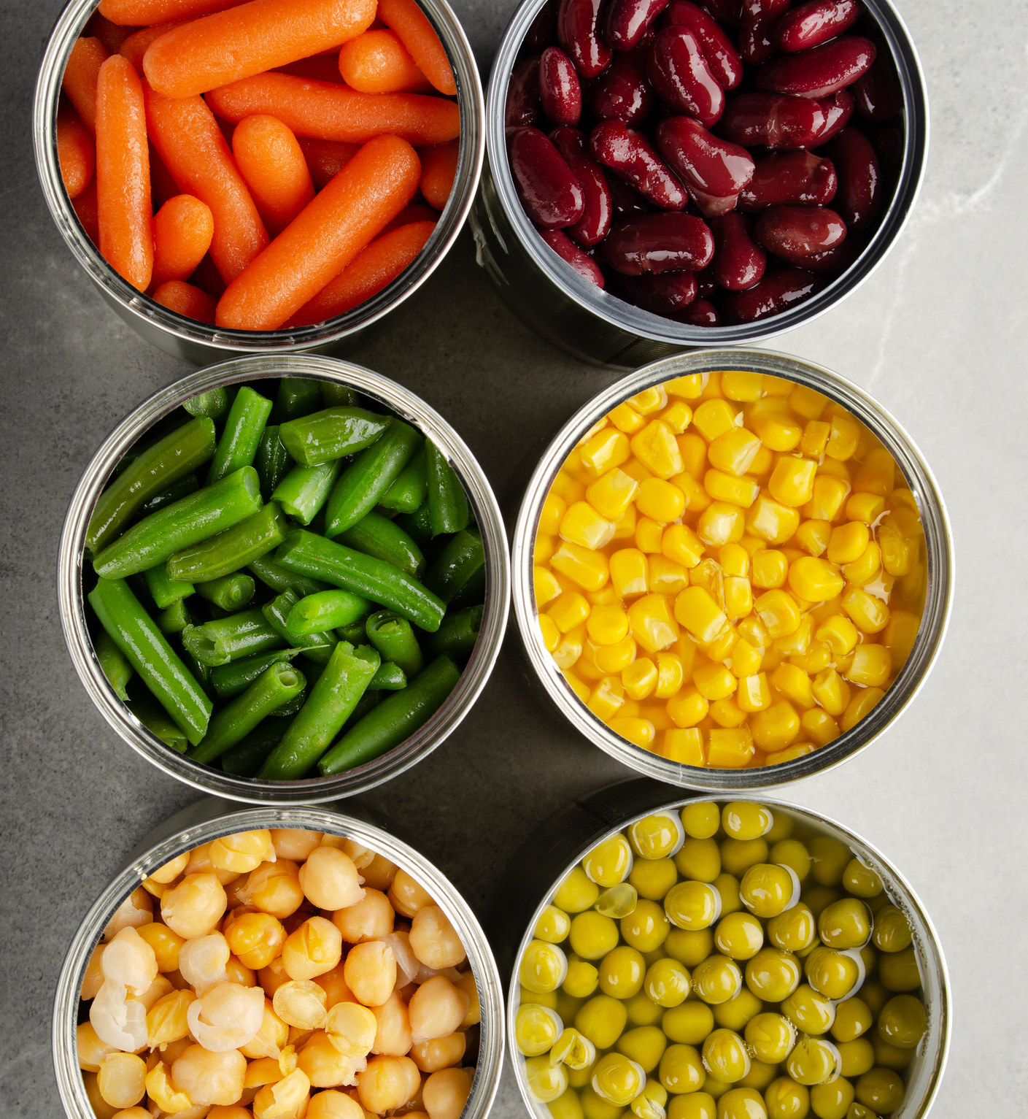
Vegetable Requirements in the CACFP
Breakfast: Vegetables, fruits, or both are required
Lunch/Supper: One vegetable is required
A second vegetable can be served in place of a fruit
Snacks: Optional
Vegetables and fruits are separate components
Notes:
In the CACFP:
At breakfast, vegetables are a combined component with fruits. This means you may credit vegetables, fruits, or a combination of vegetables and fruits as part of a reimbursable breakfast.
At lunch and supper, at least one vegetable is required. You may also serve a second, different vegetable, in place of a fruit.
At snack, vegetables are optional. Snacks in the CACFP need foods from two different meal components, so you can serve vegetables with any other meal component—such as a vegetable and fruit.
Or, you can serve a snack made up of a fruit and a grain, or milk and a meat/meat alternate.

Slide 8
Adding Vegetables to CACFP Menus
Notes:
The bottom of page 1 shows examples of different ways you can serve vegetables as part of reimbursable CACFP meals and snacks.
A breakfast meal can include vegetables, grains, and milk;
A lunch meal can include vegetables, fruits, meats or meat alternates, grains, and milk; and
A snack can include vegetables and fruits.
We will also talk about some menu flexibilities in just a bit, such as serving a meat/meat alternate in place of grains at breakfast or serving a 2nd vegetable in place of the fruit component at lunch and supper.

Slide 9
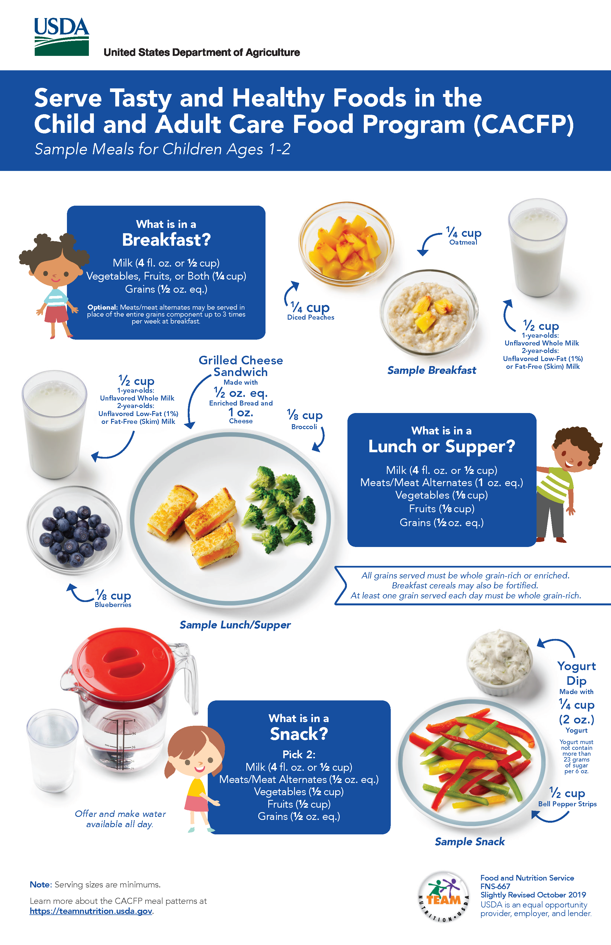
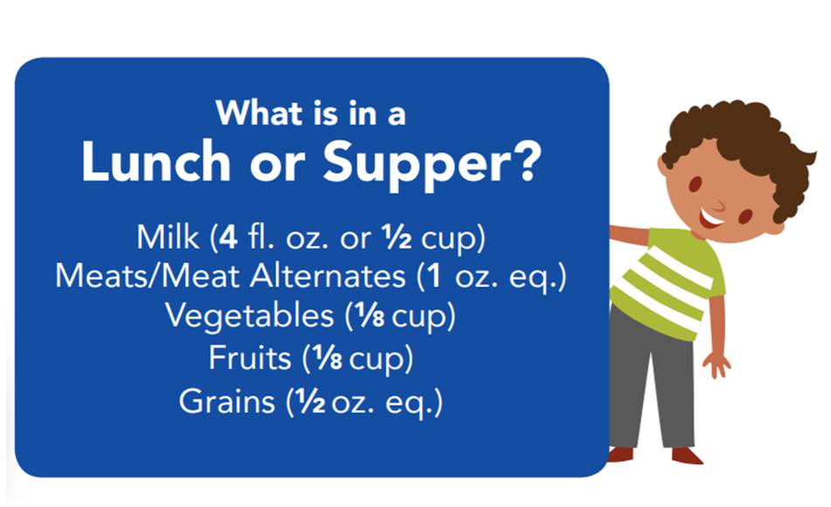
Example: Minimum Amounts for 1-2 Year Olds
Notes:
All meals and snacks in the CACFP have required minimum serving amounts for each meal component. For example, at lunch and supper, each 3, 4, or 5 year old child must be served at least:
6 fluid ounces (fl oz) of milk,
1 ½ ounce equivalent (oz eq) of meats/meat alternates,
¼ cup of vegetables,
¼ cup of fruits, and
½ ounce equivalent (oz eq) of grains.
You can serve more than the minimum serving amount of a food component, but you must serve at least the minimum amount listed.

Slide 10
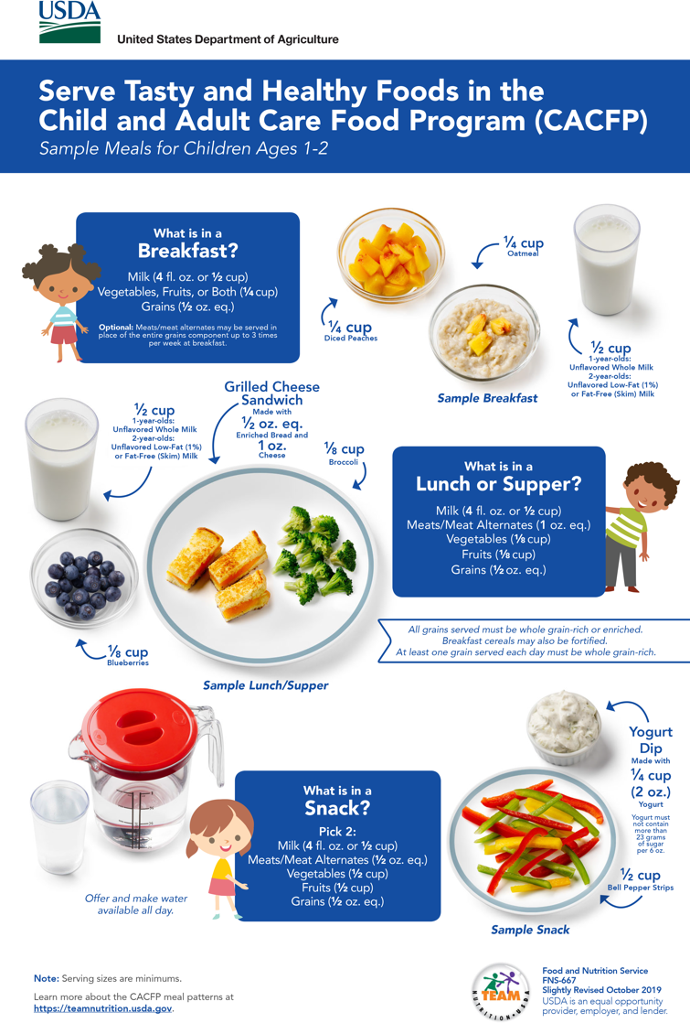
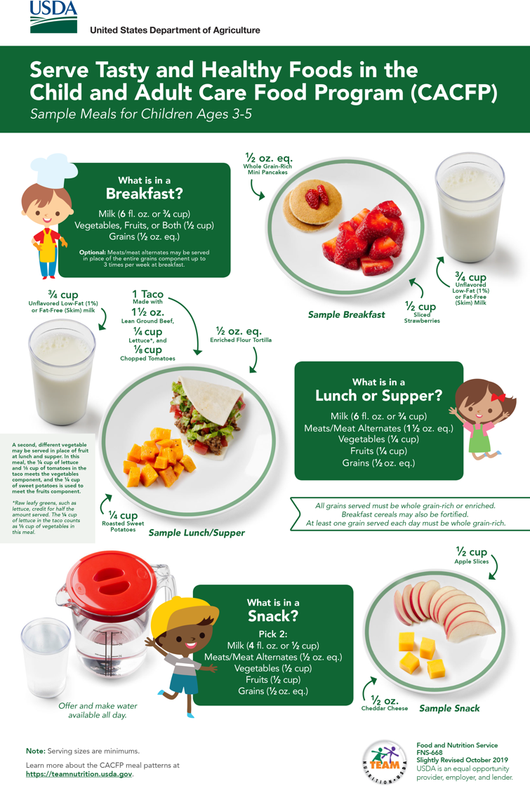
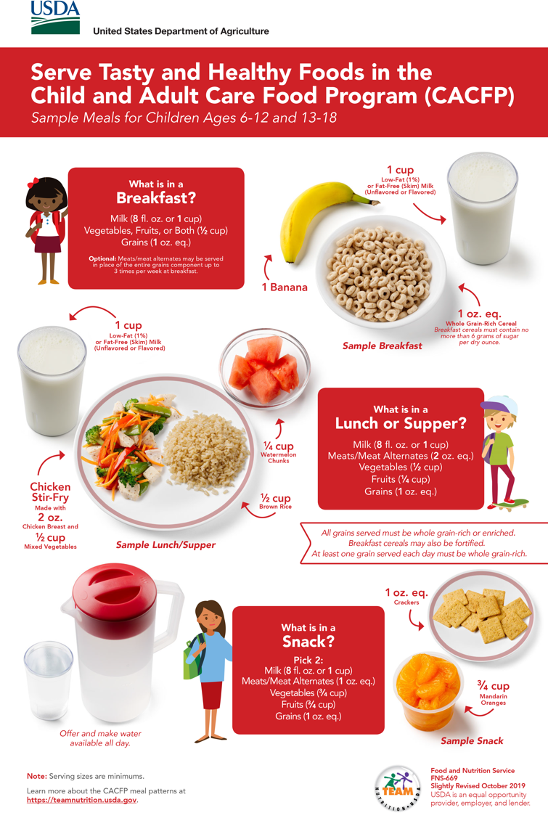
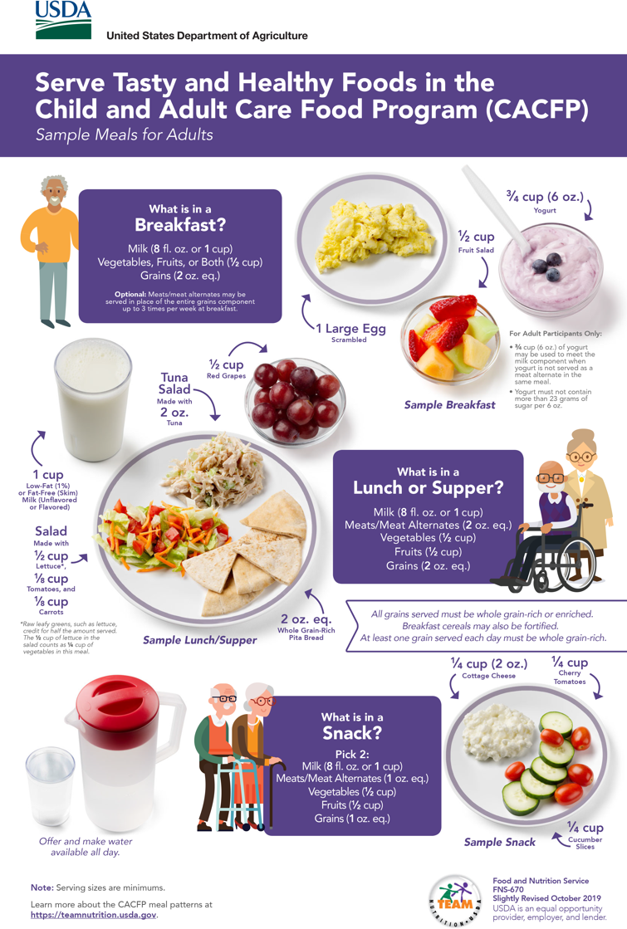
Minimum Serving Amounts
fns.usda.gov/teamnutrition
Notes:
You can find minimum serving amounts for all food components, at all CACFP meals and snacks, on Team Nutrition’s “Serve Tasty and Healthy Foods in the CACFP” posters. There is a poster for each age group for children: Ages 1 through 2 years, 3 through 5 years, 6 through 12 and 13 through 18, and a poster for adult participants.
These posters are available online and in print from the Team Nutrition website.

Slide 11
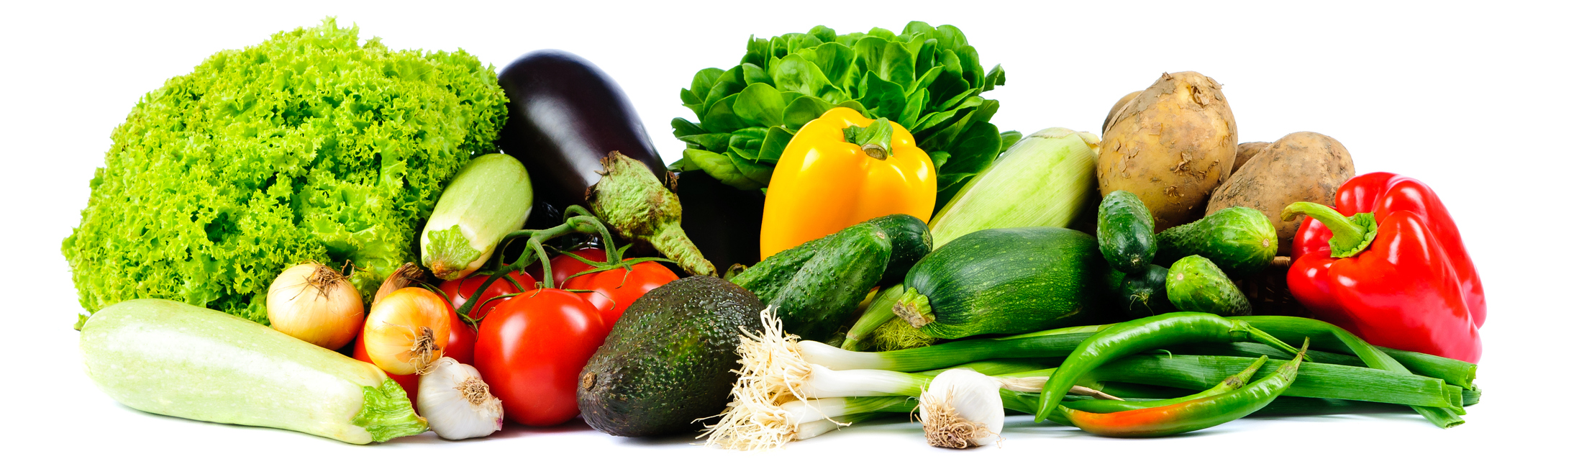
What Count as a Vegetable?
Yes
No
Commercially canned vegetables
Potatoes, corn, peas
Tomatoes, avocados, pumpkins
Whole hominy
Vegetables canned at home
Potato chips, cornbread, rice, macaroni
Ketchup, pickle relish
Hominy grits
Notes:
We know there can be some questions about what credits as a vegetable in the CACFP, so let’s go over that now.
Commercially canned vegetables, in other words, canned vegetables you might buy at the store, may credit as vegetables in a reimbursable CACFP meal or snack. However, vegetables canned in a home kitchen do not credit toward the vegetables component in the CACFP. This is because of potential food safety concerns.
Potatoes, corn, and peas may credit toward the vegetables component in the CACFP.
However, potato chips, cornbread, and vegetable straws, do NOT credit toward the vegetables component.
Potato chips and vegetable straws are not creditable in the CACFP. Cornbread, may possibly credit toward the grains component, depending on the amount served, the ingredients in the food, and other factors.
Vegetables with seeds, such as tomatoes, avocados, pumpkins, other types of squash, bell peppers, and cucumbers, etc. may be counted as part of the vegetables component.
Additionally, condiments such as ketchup or pickle relish do not credit as a vegetable.
Finally, a type of corn called hominy, may credit as a vegetable when it is served in its whole, cooked form, such as in a soup or stew. However, hominy that has been dried and ground into dry hominy grits, credit as a grain, not as a vegetable, in the CACFP.

Slide 12
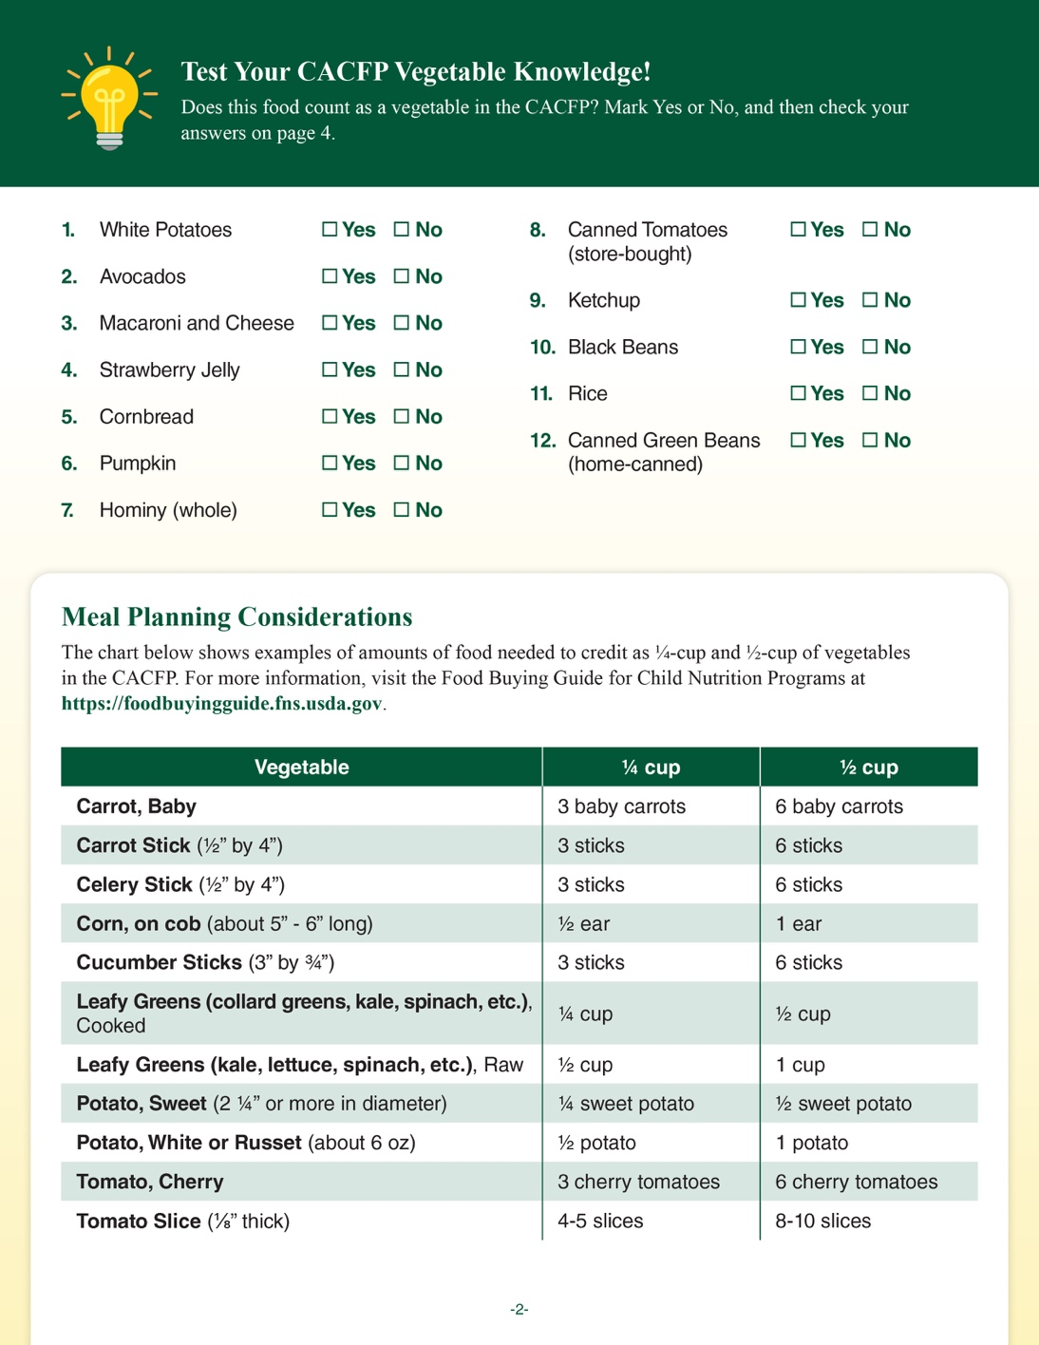
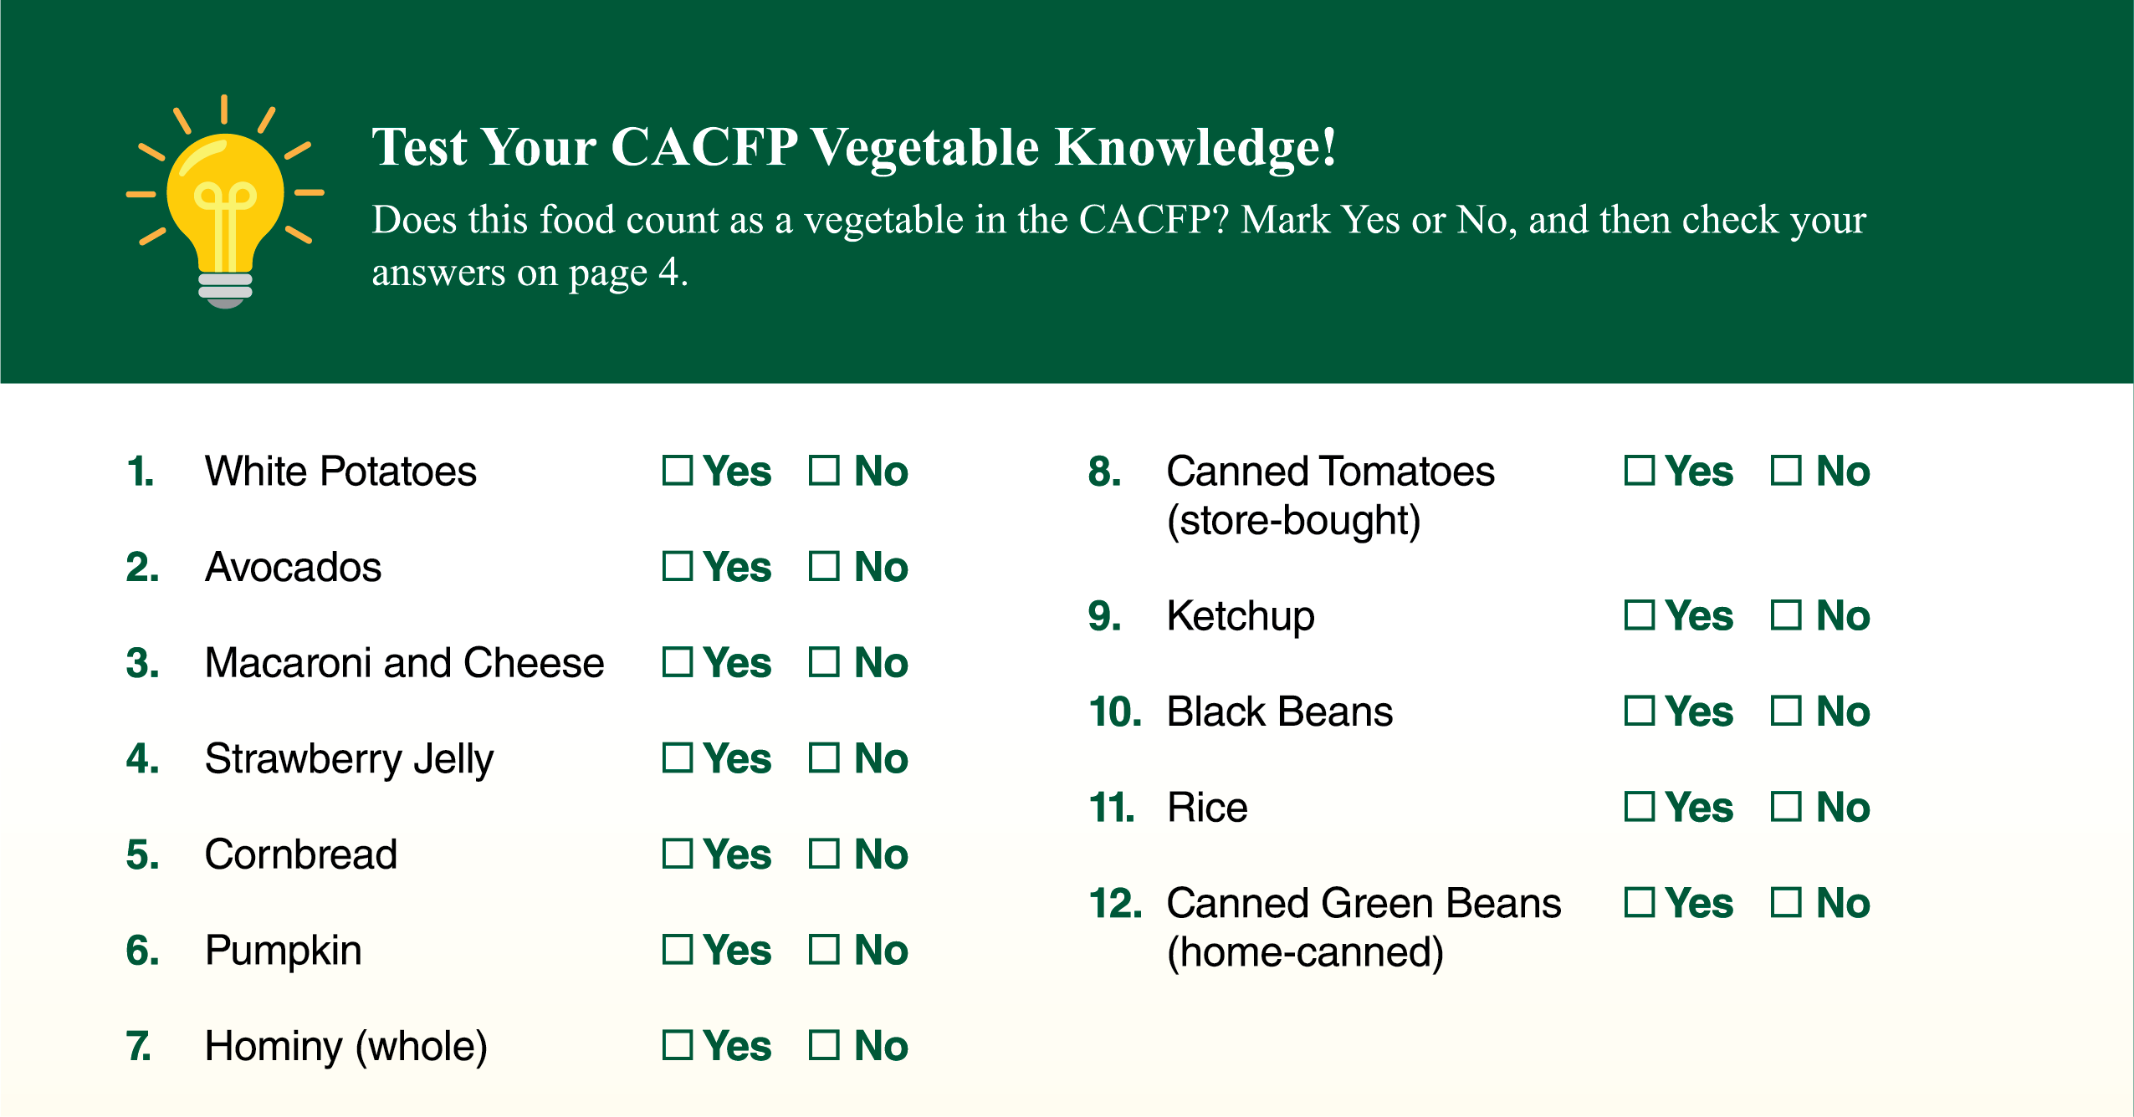
Test your CACFP Vegetable Knowledge
Notes:
If you’d like to test yourself on this information later, you can go to the “Test your CACFP Vegetable Knowledge” section on page 2 of the worksheet. The answer key is on the bottom of page 4.

Slide 13
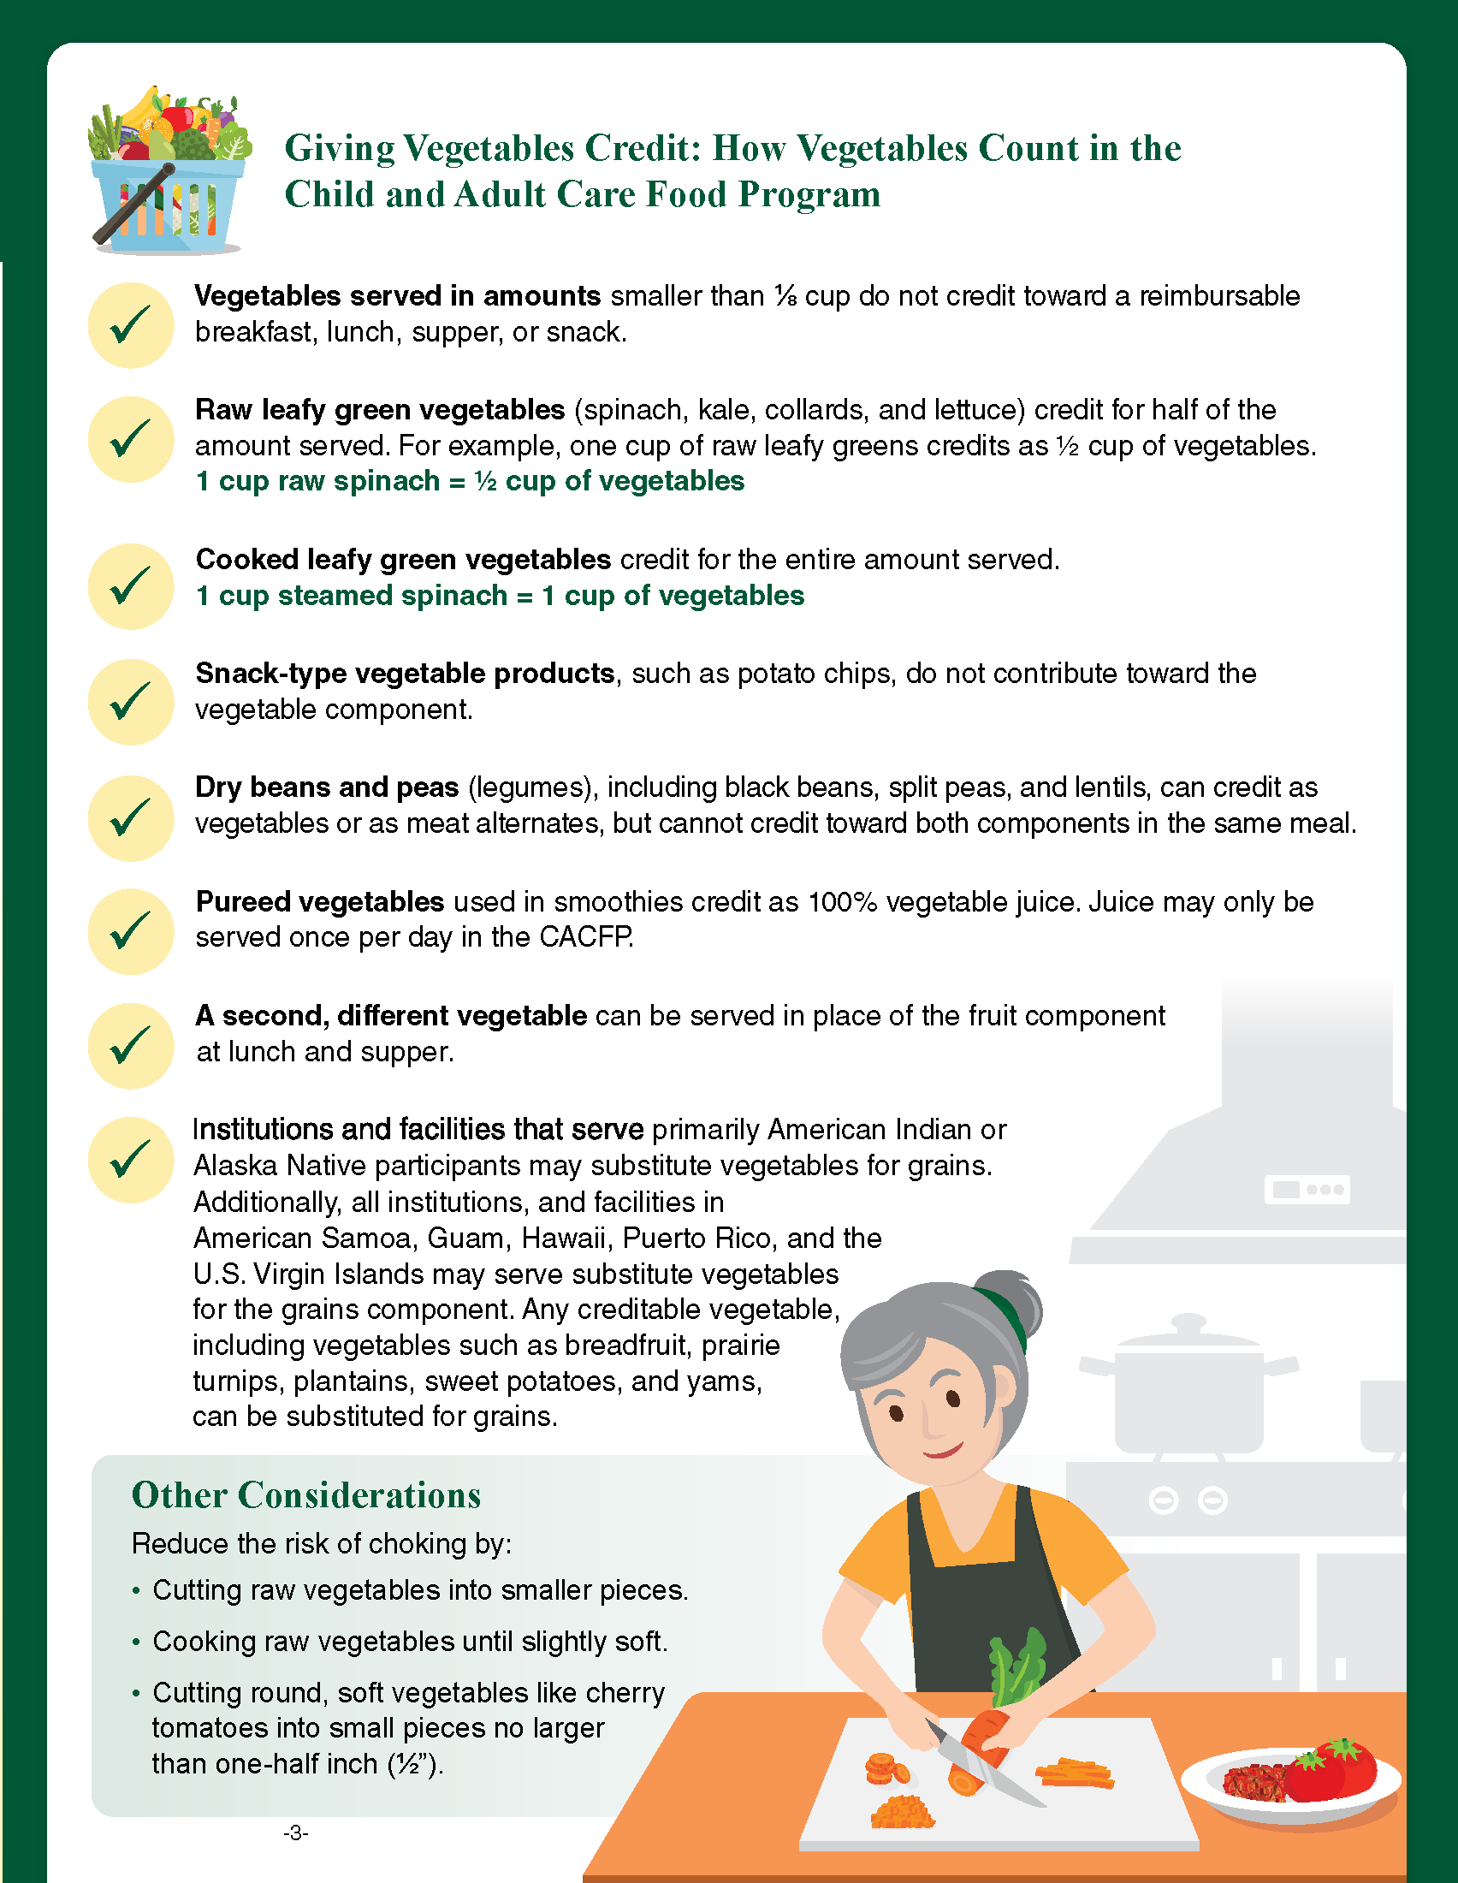
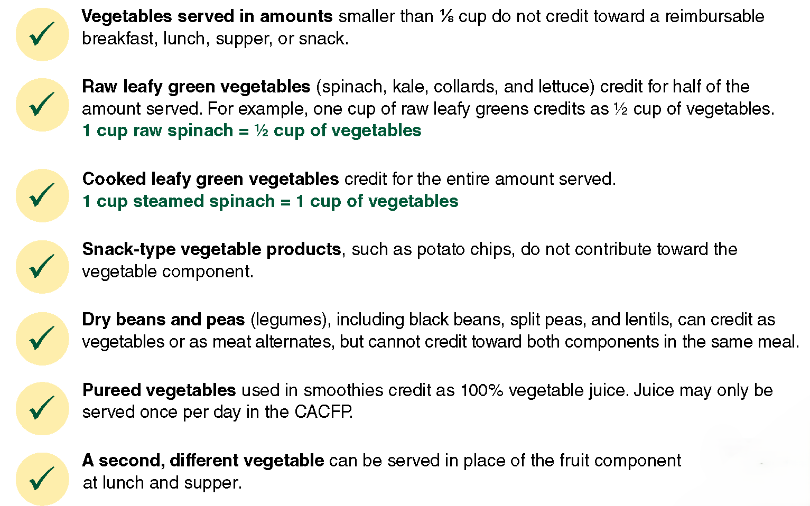
Giving Vegetables Credit
Notes:
Page 3 of the worksheet includes tips on crediting vegetables when serving them in the CACFP. These tips will help you make sure you’re serving the minimum amount of vegetables required at meals and snack. Now, let’s take a closer look at these tips.
Vegetable servings smaller than ⅛ cup do not credit.
Raw leafy greens credit as half the amount served (1 cup raw = ½ cup vegetables).
Cooked leafy greens credit for the full amount served (1 cup cooked = 1 cup vegetables).
Snack‑type vegetable products like potato chips do not credit.
Beans, peas, and lentils can credit as a vegetable or meat alternate, but not both in the same meal.
Pureed vegetables in smoothies credit as 100% juice; remember juice can only be served once per day.
A second vegetable may be served instead of fruit at lunch and supper.
Now let’s look at each of these tips a little closer.

Slide 14
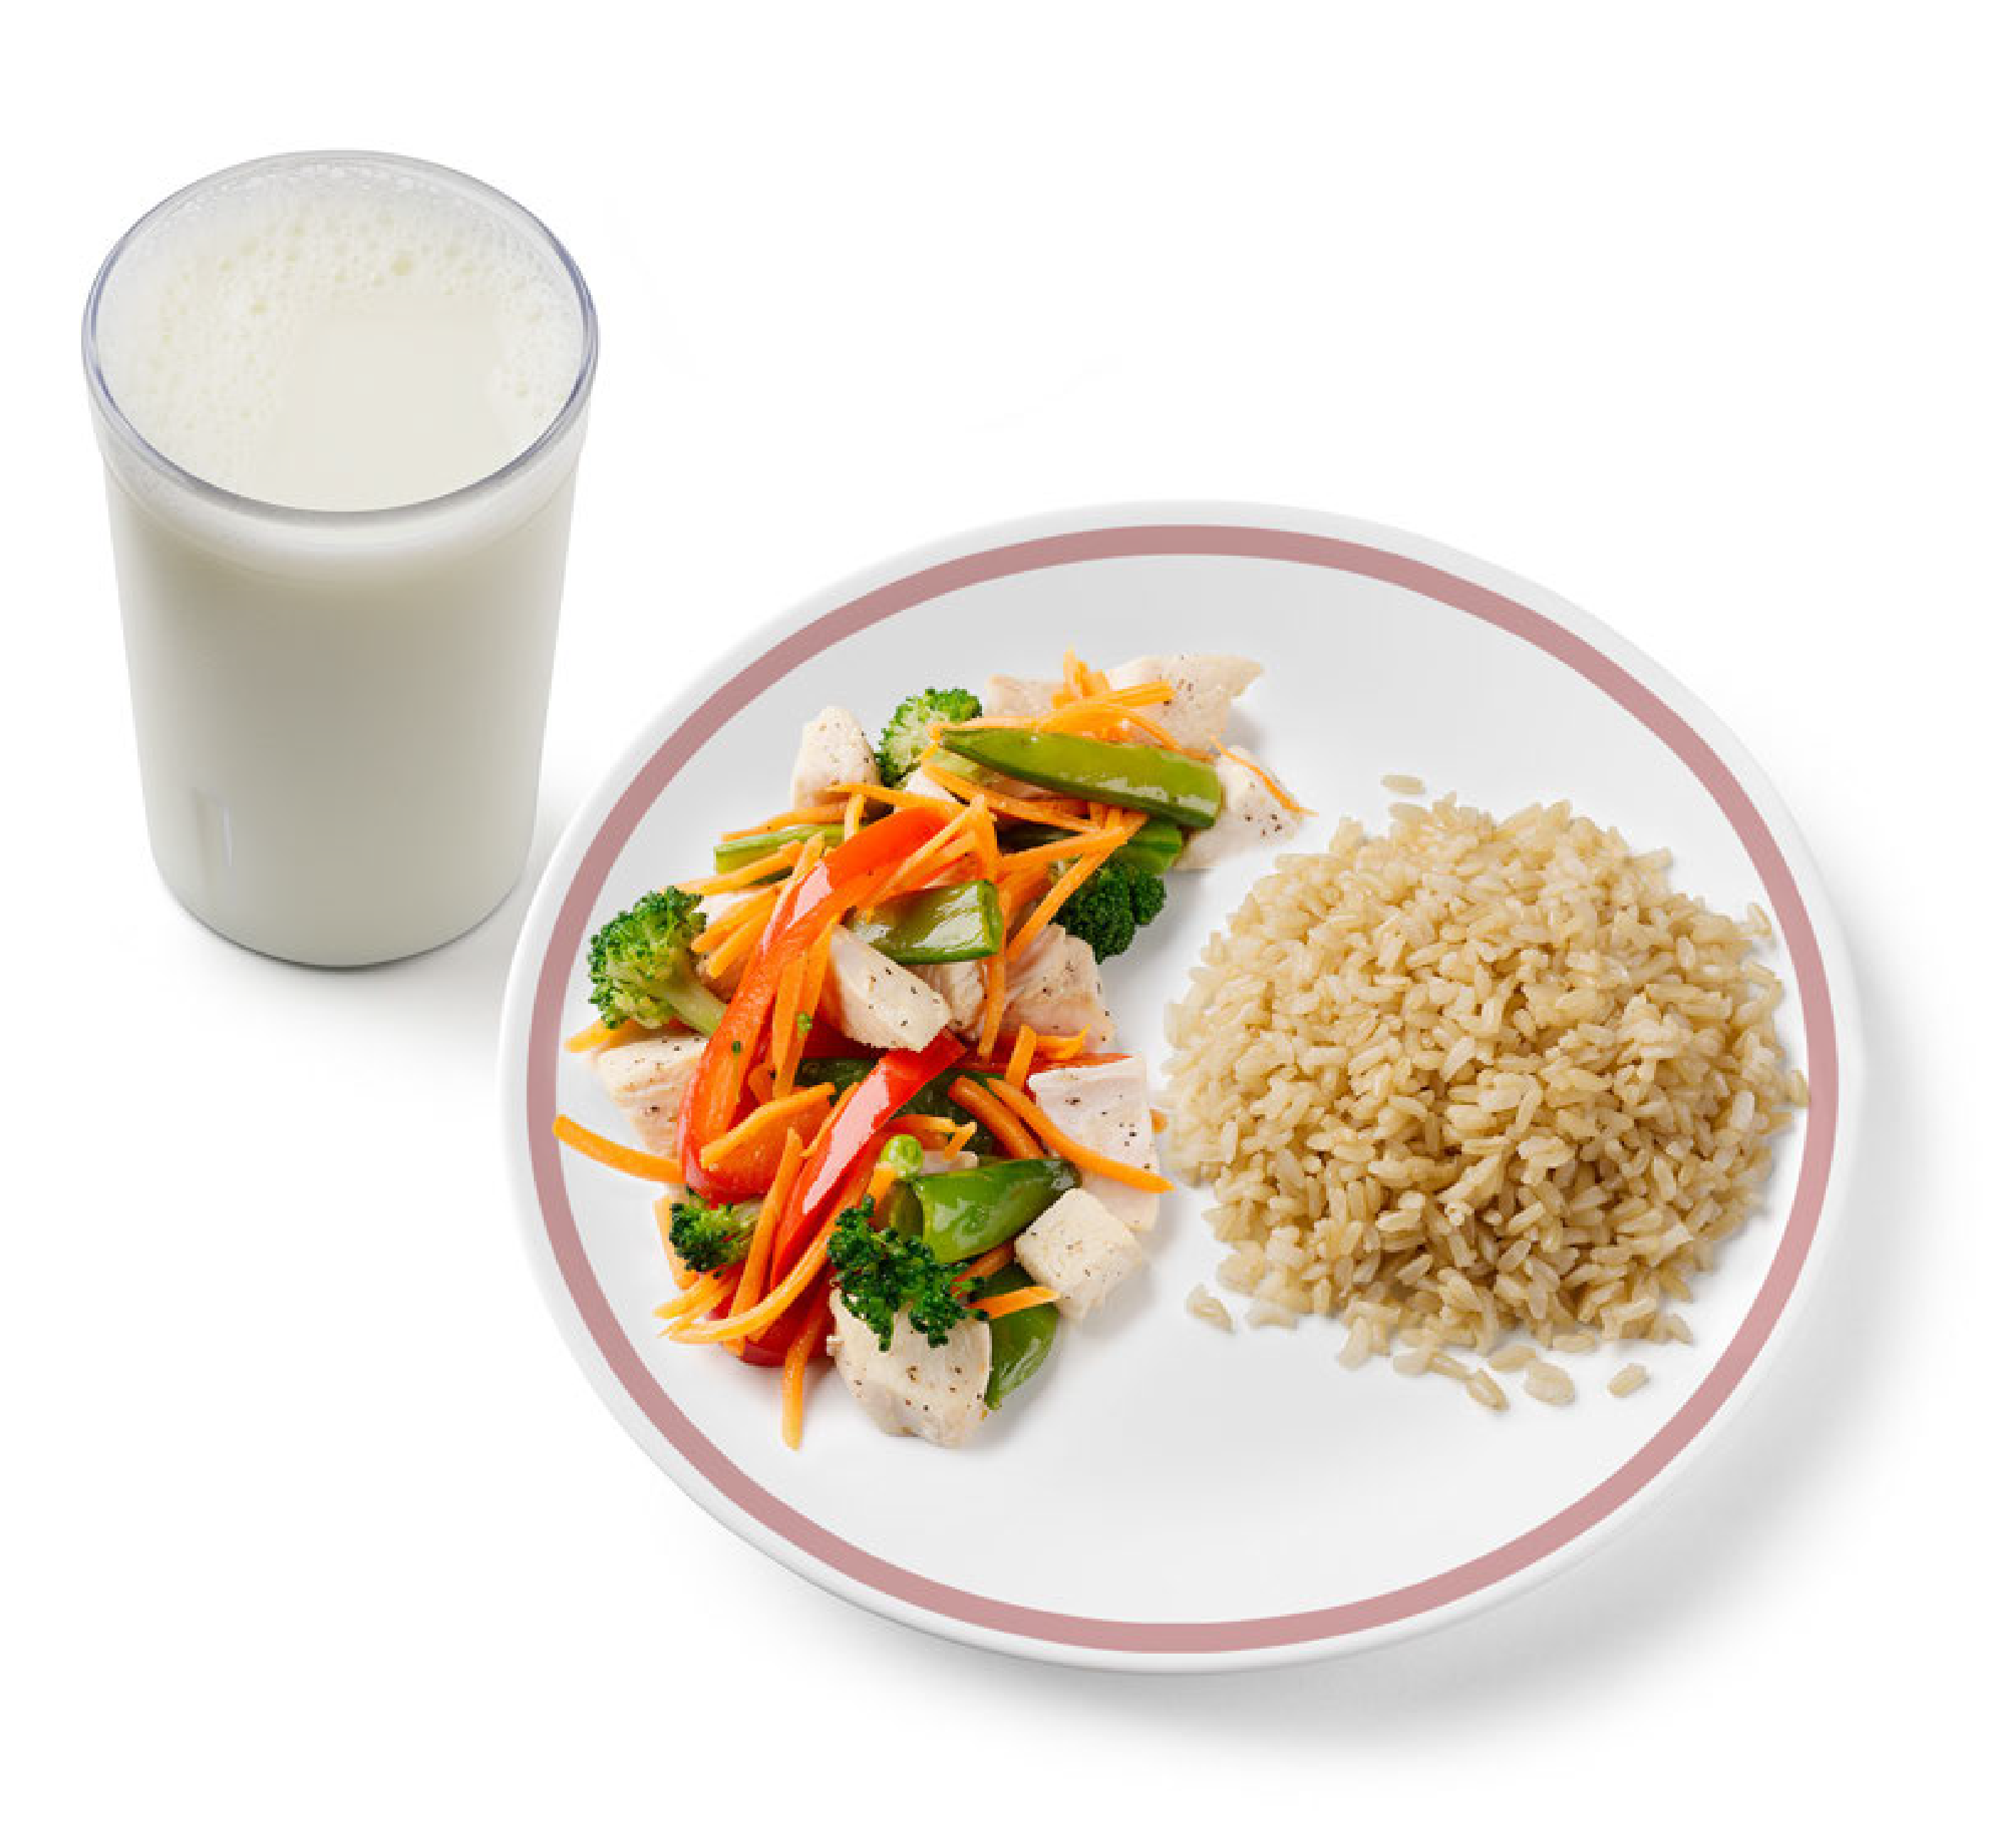
Crediting Clue #1: Crediting Vegetables
Vegetables in amounts less than ⅛ cup do not credit toward a reimbursable meal or snack.
Most vegetables credit for the amount served.
Ex: ½ cup diced carrots = ½ cup vegetable
Notes:
A food item must contain at least an ⅛ cup of vegetables per serving to count toward a reimbursable meal or snack. For example, if you serve chicken stir‑fry at lunch, each serving must include at least an ⅛ cup of vegetables to credit toward the vegetables component. If the stir‑fry provides an ⅛ cup but does not meet the full vegetable requirement for the age group you are serving, you must offer additional vegetables.
For a child ages 3–5, a serving of stir‑fry with only ⅛ cup of vegetables would require extra vegetables to meet the meal pattern. If the stir‑fry contains ¼ cup or more, no additional vegetables are needed.
Most vegetables credit based on the amount served. For example, ½ cup of cooked, diced carrots credits as ½ cup toward the vegetable component.

Slide 15
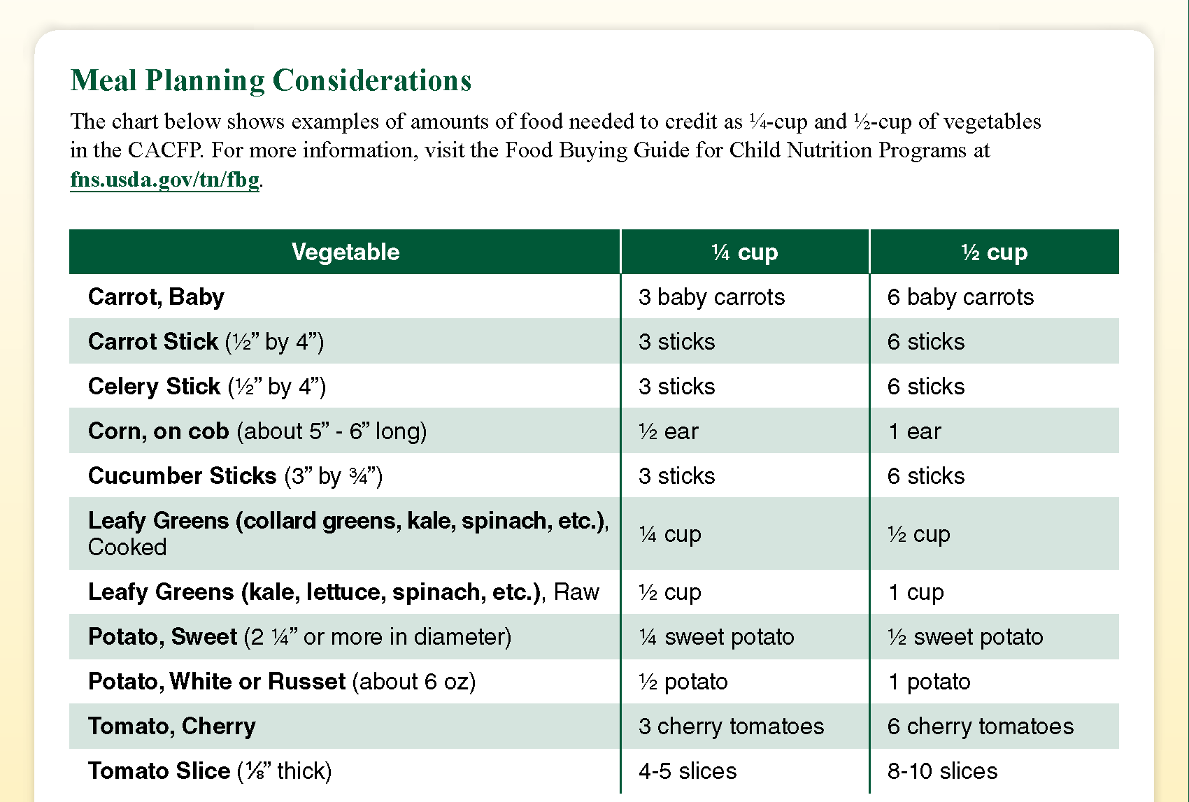
Crediting Clue #2: Crediting Vegetables
Cooked leafy greens
¼ cup sautéed spinach = ¼ cup of vegetables
Raw leafy greens
½ cup raw spinach = ¼ cup of vegetables
Dried vegetables served
½ cup sun-dried tomatoes = 1 cup of vegetables
Notes:
If you look at the chart, you’ll notice that cooked leafy greens, such as cooked collard greens, kale, spinach, etc., credit for the amount served. Again, this means that ¼ cup sauteed spinach credits as a ¼ cup toward the vegetables component.
However, if the leafy green is served raw, like raw kale, raw lettuce, or raw spinach, it credits for half the amount served. This means you’d have to serve ½ cup raw spinach to credit for ¼ cup vegetables.
Dried vegetables credit for twice the amount served. So, if you serve a ½ cup of sundried tomatoes, it would credit as 1 cup of vegetables.

Slide 16
Crediting Clue #3: Common Vegetable Servings
Notes:
On page 2 of the worksheet, you can find a chart of amounts of common vegetables needed to make up a ¼ cup and ½ cup serving of vegetables.

Slide 17
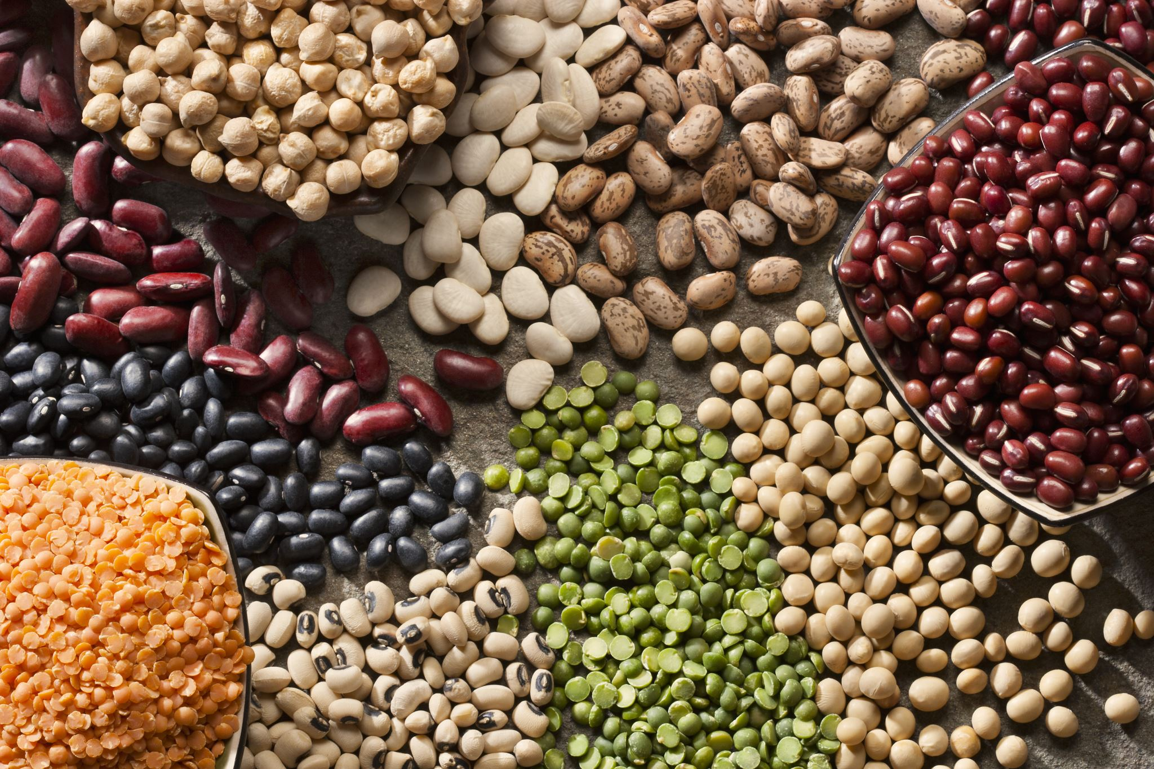
Crediting Cue #4: Crediting Vegetables
Beans, peas, and lentils may credit as vegetables OR meat alternates.
They may not credit as both in the same meal.
Notes:
The next piece of information to share is related to beans, peas, and lentils. These foods may credit as vegetables OR meat alternates in the CACFP. They cannot credit as both in the same meal. Some examples of items in this group include black beans, chickpeas, black-eyed peas, pinto beans, lima beans, etc. Both the Dietary Guidelines and the Real Food Pyramid highlight legumes as nutrient‑dense, fiber‑rich foods that contribute to a healthy diet.

Slide 18

Crediting Cue #5: Crediting Vegetables
Juice may be served once per day to children and adults in the CACFP.
Pureed vegetables or fruits used in smoothies credit as juice.
Notes:
Additionally, 100% juice of any kind may be served in the CACFP only once per day to child and adult participants. Juice is not allowed for infants. This means that if you serve vegetable juice at breakfast—such as tomato juice, or carrot juice, you cannot credit fruit or vegetable juice as part of a reimbursable lunch, supper or snack that same day. Also, if you are serving vegetables or fruits as part of a smoothie, the pureed vegetables or fruit credit as juice.

Slide 19
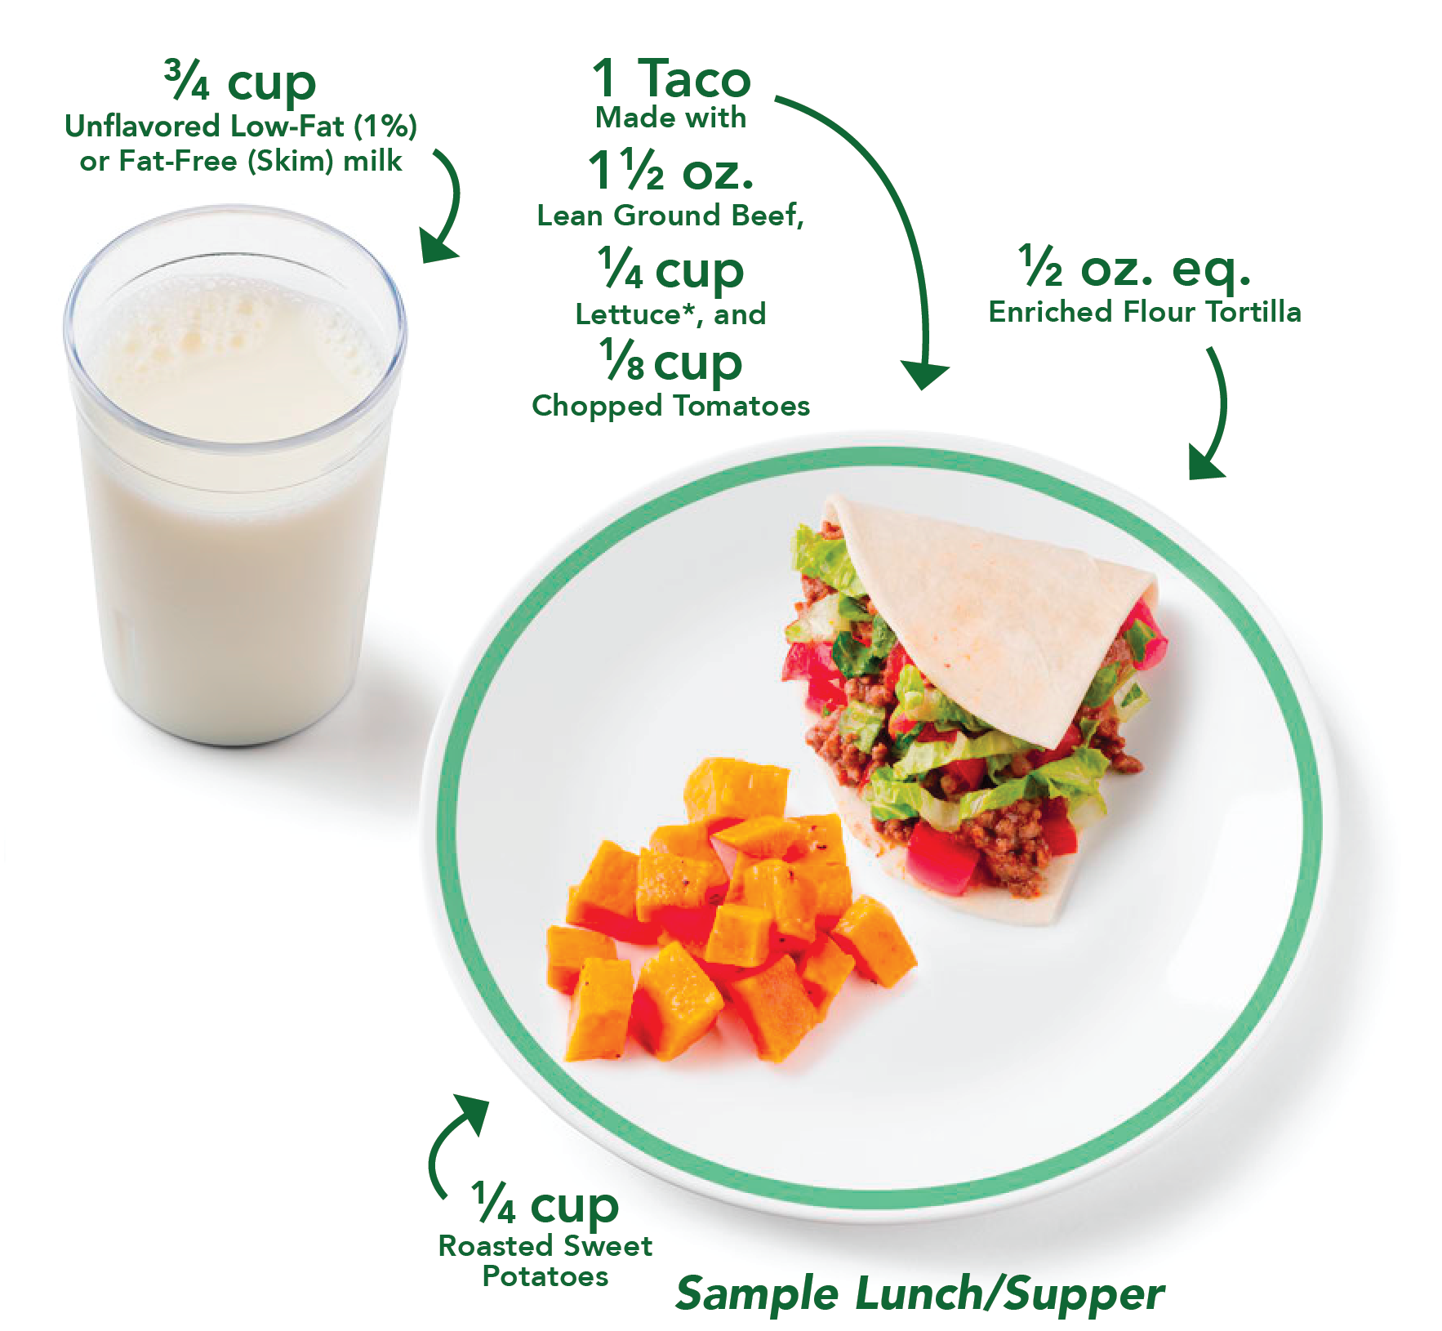
Crediting Cue #6: Crediting Vegetables
Dry beans and peas (legumes) may credit as vegetables OR meat alternates.
Juice may be served once per day to children and adults in the CACFP.
Vegetables or fruits used in smoothies credit as juice
At lunch and supper, a second, different vegetable can be served in place of fruit.
Notes:
As we mentioned at the beginning of today’s presentation, at lunch and supper, you can serve a second, different vegetable in place of fruit. For example, in the lunch for 3 through 5-year-olds shown on the slide, the tomatoes and lettuce in the taco fulfill the ¼ cup of vegetables required at lunch. To meet the fruit component, the menu planner is serving a different type of vegetable, the roasted sweet potatoes, instead of a fruit.

Slide 20
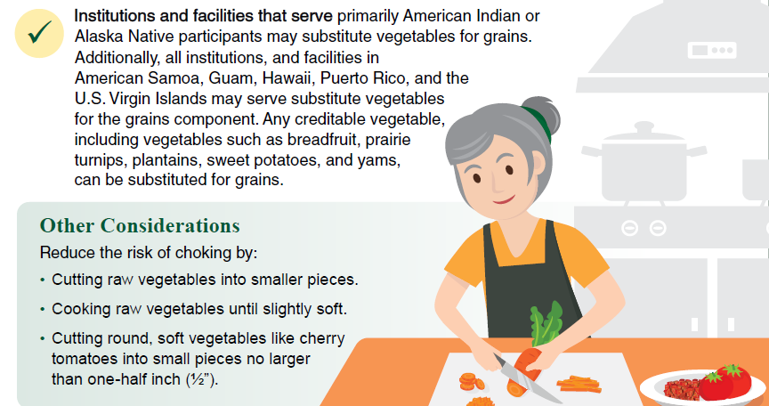
Crediting Clue #7: 2024 Final Rule Update
Notes:
And lastly, as of July 1, 2024, institutions and facilities that serve primarily American Indian or Alaska Native participants may substitute vegetables for grains. Additionally, all institutions, and facilities in American Samoa, Guam, Hawaii, Puerto Rico, and the U.S. Virgin Islands may substitute vegetables for the grains component.
For additional information, use the link on the screen to read the policy memo “Substituting Vegetables for Grains in American Samoa, Guam, Hawaii, Puerto Rico, the U.S. Virgin Islands, and Tribal Communities” issued on October 30, 2024. A document with frequently asked questions is also available on the same webpage.
Now let’s talk a little about preparing vegetables safely.

Slide 21

Tips for Preparing Vegetables Safely
Cut round, soft vegetables into
smaller pieces
(½-inch or smaller)
Cut raw vegetables into smaller pieces
Cook raw vegetables until slightly soft
Notes:
If you are serving children under the age of 4, we strongly encourage you to modify the texture of vegetables to prevent choking. Some modifications include:
cutting raw vegetables into smaller pieces,
cooking raw vegetables until they are slightly soft, and/or
cutting round, soft vegetables such as cherry tomatoes into smaller pieces—at least ½ inch or smaller.
For more information on choking prevention in young children see the CACFP Training Worksheet “Reducing the Risk of Choking in Young Children at Mealtimes” at the web address on the slide.
These modifications may also make it easier for older participants to eat vegetables too, such as the 6-year-olds in your afterschool program who might be losing their baby teeth or the 10- or 11-year-olds who have braces. It can also make it easier for the adult participants who may have dentures, bridges, or other dental considerations to enjoy vegetables.

Slide 22
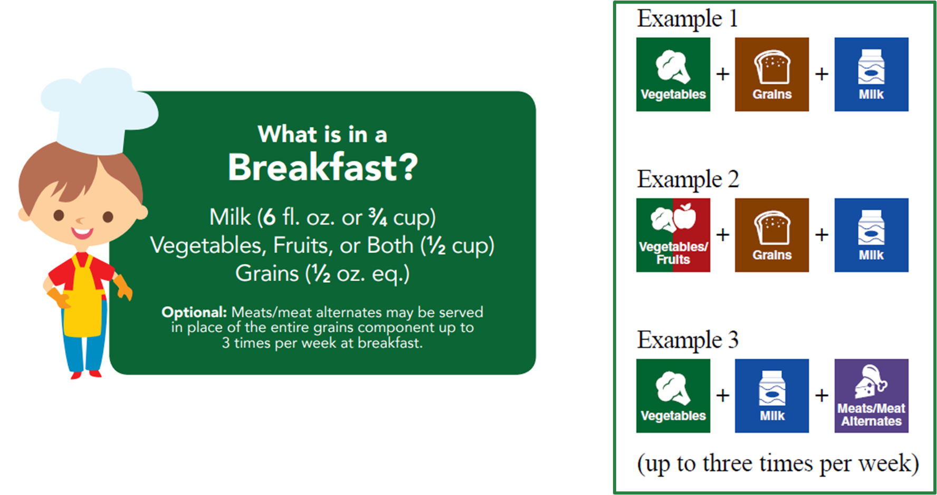
Serving Vegetables at Breakfast
Notes:
Now that we’ve talked about what’s considered a vegetable, and the amount of vegetables needed at meals and snacks, let’s talk more about how vegetables can be served with other foods to make a reimbursable meal.
As mentioned earlier, at breakfast, vegetables and fruit are a combined component.
A reimbursable breakfast in the CACFP contains foods from three different meal components. The meal components are:
Milk,
Grains
Fruit, Vegetable, or both.
You can meet this requirement in a few different ways.

Slide 23



Serving Vegetables at Breakfast Example 1
Vegetable
Vegetable + Vegetable
Notes:
You may choose to serve one single vegetable. The requirement for vegetables/fruit at breakfast for children ages 3–5 is ½ cup. This means you could serve ½ cup of avocado with toast and milk, to meet this requirement as shown on the left side of the screen.
Now, let’s look at the right side of the screen. You may choose to serve two or more vegetables to meet the minimum amount. For example, you may serve a ¼ cup of avocados and a ¼ cup of tomatoes to each participant to make up a ½ cup of vegetables. Now, if this meal is on your menu for 3-5 year olds, you’d also want to make sure to cut the cherry tomatoes into small pieces to reduce the risk of choking.
Please note that the pictures of foods in this presentation are not shown to scale—meaning that a ½ cup of avocados may not be an entire avocado, or that a ¼ cup of grape tomatoes may not be exactly 6 tomatoes. The pictures are meant to give you a visual idea of the types of foods that make up a reimbursable CACFP meal.

Slide 24
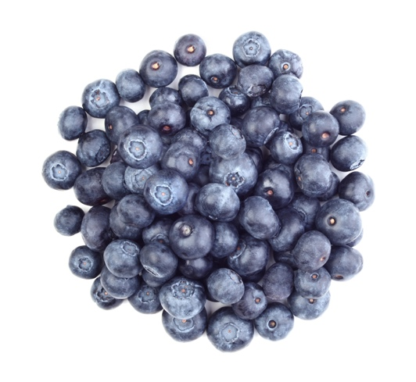

Serving Vegetables at Breakfast Example 2
Vegetable + Fruit
Fruit
Fruit + Fruit
Notes:
You can also combine vegetables and fruits to meet the requirement at breakfast. Using our same example of the ½ cup requirement at breakfast for 3 through 5-year-olds, you could serve ¼ cup of avocados and ¼ cup of blueberries, as shown on the left side of the screen.
You can also serve just fruit to meet the requirement—so you can serve a ½ cup of blueberries as shown in the middle—or you can serve two or more different fruits—such as a ¼ cup of blueberries and a ¼ cup of peaches.

Slide 25

Serving Vegetables at Breakfast Example 3
Vegetable + Fruit
Fruit
Fruit + Fruit
Notes:
You can also combine vegetables and fruits to meet the requirement at breakfast. Using our same example of the ½ cup requirement at breakfast for 3 through 5-year-olds, you could serve ¼ cup of avocados and ¼ cup of blueberries, as shown on the left side of the screen.
You can also serve just fruit to meet the requirement—so you can serve a ½ cup of blueberries as shown in the middle, with the oatmeal—or you can serve two or more different fruits—such as a ¼ cup of blueberries and a ¼ cup of peaches.

Slide 26

Try It Out 1!
?
Which breakfasts are reimbursable?
Choose all that apply:
Milk, roasted sweet potatoes, enriched waffle
Milk, whole grain-rich English muffin, fruit salad
Milk, black beans, potatoes, orange slices
Milk, cottage cheese,
whole grain-rich bagel
Notes:
I know I just gave you a lot of information about vegetables at breakfast, so let’s put it into practice with a quick knowledge check.
Look at the four breakfast options on the screen. Assume there is enough of each item to meet the minimum amounts required. Which breakfast meals listed below are reimbursable in the CACFP?
The choices are:
Milk, roasted sweet potatoes, enriched waffle [pause and wait for a show of hands];
Milk, whole grain-rich English muffin, fruit salad [pause and wait for a show of hands];
Milk, black beans, potatoes, orange slices [pause and wait for a show of hands]; or
Milk, cottage cheese, whole grain-rich bagel.

Slide 27
Try It Out 1!
Answer
Which breakfasts are reimbursable?
?
The correct answers are:
Milk, roasted sweet potatoes, enriched waffle
Milk, whole grain-rich English muffin, fruit salad
Milk, rice, black beans, potatoes, orange slices
Milk, cottage cheese,
whole grain-rich bagel
Vegetable
Fruit
Vegetables
Meat Alternate
No Vegetable
No Fruit
Notes:
If you said meals A, B, and C are reimbursable you are correct. Now let’s go through this together.
Breakfast A is reimbursable, because you have roasted sweet potatoes as a vegetable.
Breakfast B is reimbursable, because you have fruit salad as a fruit.
Breakfast C is reimbursable, because you have potatoes as your vegetable, and beans as your meat alternate. Orange slices are extra.
Breakfast D is NOT reimbursable because you do not have a fruit or a vegetable.

Slide 28
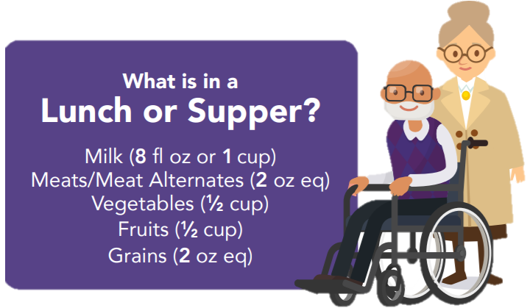
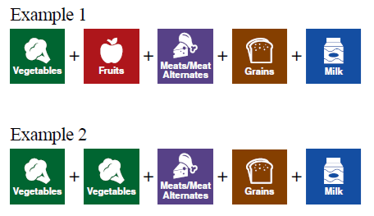
Serving Vegetables at Lunch/Supper
Meal Pattern Shown for Adults
Notes:
Now, let’s talk about serving vegetables at lunch or supper in the CACFP.
A reimbursable lunch or supper in the CACFP contains foods from all five meal components. The meal components are:
Milk,
Meats/Meat Alternates,
Vegetables,
Fruits, and
Grains.

Slide 29


Vegetables at Lunch/Supper Examples
Vegetable + Fruit
Vegetable + Vegetable
Notes:
At lunch and supper, vegetables and fruits are two separate components. This means you need to serve at least one vegetable, and at least one fruit.
In the example shown on the left side of the screen, broccoli and fruit salad are provided to meet the fruit and vegetable requirements. Again, you want to make sure you are serving at least the minimum amount of each meal component for the age of the participant you are serving.
For example, let’s say this lunch is for adult participants. The minimum serving amount for adults at lunch and supper in the CACFP is a ½ cup of vegetables, and a ½ cup of fruit. So, if you are serving this meal to adults, you want to make sure you serve at least a ½ cup of broccoli and a ½ cup of fruit salad to each participant, as part of a reimbursable meal.
You also have the option to serve a second, different vegetable in place of the fruits component. This is shown on the right side of the screen, where you have broccoli as one vegetable, and red bell pepper strips as the second vegetable, served in place of a fruit.
The amount of the second vegetable you serve must be the same, or more than, the required minimum amount of the fruit. So, in this lunch for adult participants, you want to make sure each participant receives a ½ cup of broccoli to meet the ½ cup vegetables requirement. You also want to serve a ½ cup of red peppers as well, because the fruit requirement for adult participants at lunch/supper is a ½ cup.

Slide 30
Vegetables at Lunch/Supper Example 2
One Vegetable
Fruit + Fruit
Notes:
Keep in mind that the option to serve a second vegetable in place of a fruit does not mean that you can serve a second portion of the same vegetable in place of the fruit. In other words, you could not serve two half-cup portions of broccoli to meet the ½ cup of vegetables, and the ½ cup of fruits, required at lunch for adults. You must serve two different vegetables.
Similarly, you may not substitute the vegetable component with fruit at lunch and supper. For example, the meal on the right that includes two different fruits, is not a reimbursable meal because it does not contain a vegetable.

Slide 31

Try It Out 2!
?
Which lunches are reimbursable?
Choose all that apply:
Milk, whole-wheat noodles, sauteed tofu with broccoli, pineapple chunks
Milk, turkey burger on whole-wheat bun, carrot sticks, spinach salad
Milk, grilled chicken, dinner roll, apple slices, grapes
Milk, spaghetti with meatballs, roasted cauliflower, steamed cauliflower
Notes:
Ok, let’s put this information into practice again with a quick knowledge check.
Look at the four lunch options on the screen. Assume there is enough of each food in each lunch to meet minimum serving requirements. Which lunches are reimbursable in the CACFP?
Note that I said “lunches”—so this means more than one lunch will be reimbursable.
Raise your hand if you think the answer is:
A) Milk, whole-wheat noodles, sautéed tofu with broccoli, and pineapple chunks [pause and wait for a show of hands];
B) Milk, turkey burger on whole-wheat bun, carrot sticks, and spinach salad [pause and wait for a show of hands];
C) Milk, grilled chicken, dinner roll, apple slices, and grapes [pause and wait for a show of hands]; or
D) Milk, spaghetti with meatballs, roasted cauliflower, and steamed cauliflower [pause and wait for a show of hands].

Slide 32
Try It Out 2!
Answer
Which lunches are reimbursable?
?
The correct answers are:
Milk, whole-wheat noodles, sautéed tofu with broccoli, pineapple chunks
Milk, turkey burger on whole-wheat bun, carrot sticks, spinach salad
Milk, grilled chicken, dinner roll, apple slices, grapes
Milk, spaghetti with meatballs, roasted cauliflower, steamed cauliflower
Vegetable
Fruit
Vegetable
Vegetable
Fruit
Fruit
One Vegetable
Notes:
Great job everyone!! Let’s go through this together now:
Lunch A is reimbursable, because you have broccoli as your vegetable, and pineapple chunks as your fruit.
Lunch B is reimbursable, because you have carrot sticks as your vegetable, and spinach salad as a second, different vegetable in place of the fruit.
Lunch C is not reimbursable, because you have two fruits—apple slices and grapes, but no vegetables.
Lunch D is not reimbursable, because you are only serving one vegetable—cauliflower. Even though you are serving them two different ways—one roasted, one steamed—they are still the same food so you cannot count one as a vegetable to be served in place of fruit.

Slide 33
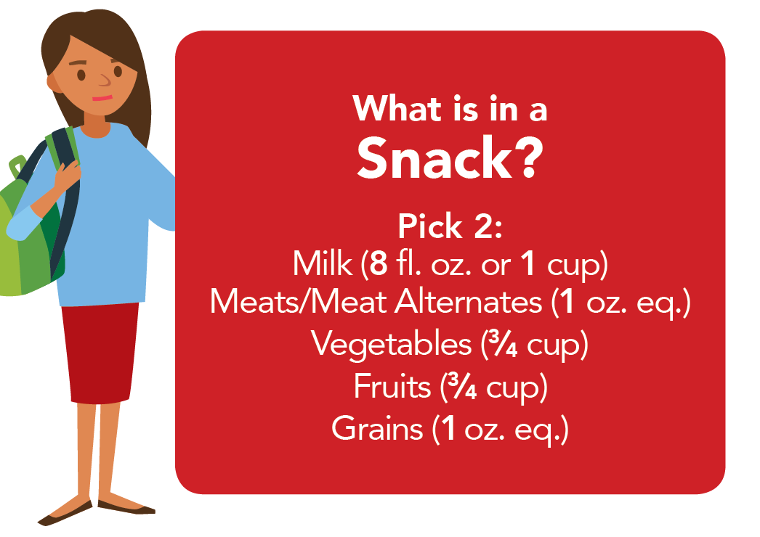
Serving Vegetables at Snack
Meal Pattern Shown for Children Ages 6-12 and 13-18
Notes:
Finally, let’s talk about serving vegetables at snack in the CACFP.
Reimbursable snacks in the CACFP contain foods from two different food components. The food components are:
Milk,
Meats/Meat Alternates,
Vegetables,
Fruits, and
Grains.
This means that vegetables are optional, but not required, at CACFP snacks.

Slide 34
Serving Vegetables at Snack Examples
Vegetable + Meat Alternate
Vegetable + Milk
Notes:
If you want to serve vegetables at snacks, here are some examples of how you can do so. You can serve vegetables, such as cucumbers and cherry tomatoes, with a meat alternate, such as cottage cheese. You can also serve vegetables like bell peppers, with milk, which counts toward the milk component.
Just like with CACFP breakfast, lunches, and suppers, you want to make sure you serve enough of the food to meet required minimum serving amounts for each component.
So, if you are serving the snack on the left to your 6- through 18-year-olds, you want to make sure you are serving at least ¾ cup of cucumbers and cherry tomatoes to meet the vegetable requirement for this age group. You also want to serve enough cottage cheese to meet the 1 oz. eq. requirement for meat alternates for this age group. Water cannot be counted as a component in the CACFP, but as a best practice, USDA encourages you to offer water with snacks if other beverages, like milk or juice, are not offered.
For the example on the right, you want to make sure you are serving at least ¾ cup of bell peppers for the vegetable component, and at least 1 cup of milk if you are serving your 6-through 18-year-olds. You can serve a dip as an extra or additional food.

Slide 35
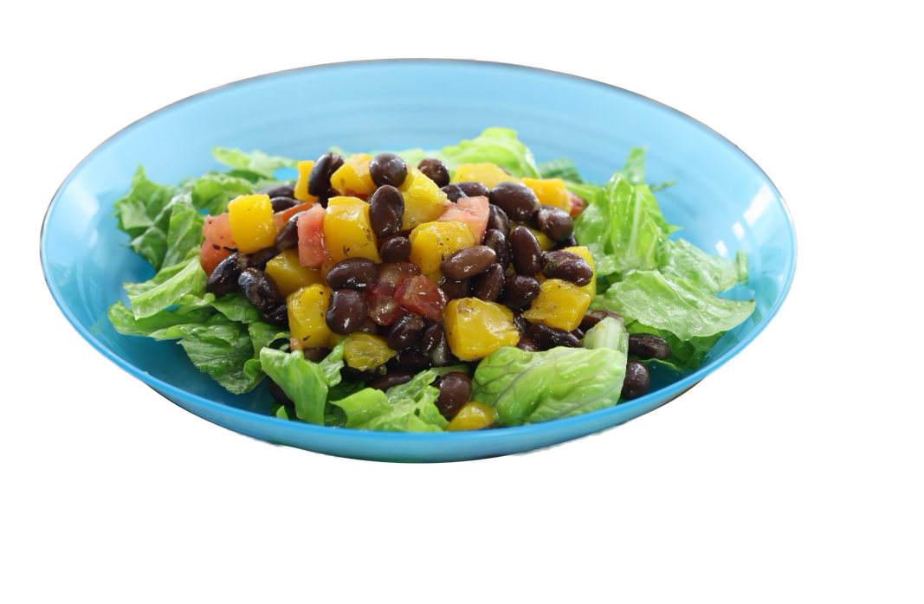
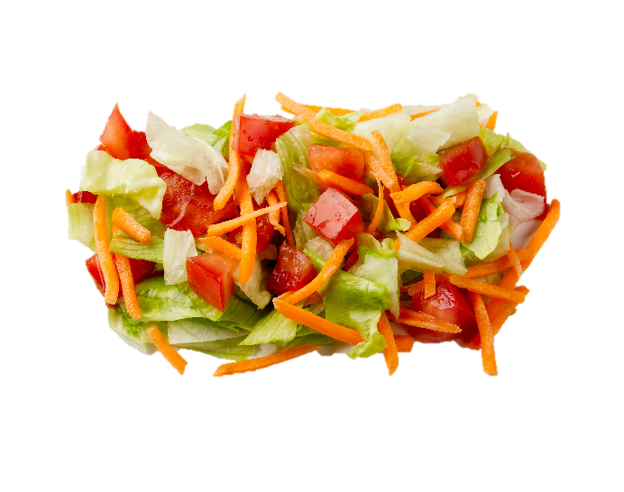
Serving Vegetables at Snack More Examples
Vegetable + Fruit
Vegetable + Grain
Notes:
You can also serve vegetables with fruit, as shown in this Tropical Bean Salad, and again make sure that you serve enough vegetable and enough fruit to meet the minimum serving amounts required for both components. Or, you can serve vegetables with grains, such as a garden salad with whole grain-rich crackers.
Remember, because vegetables are optional at snack, you can choose to serve two other components. One example might be peaches and yogurt, which satisfy the fruits and meat alternate components. Another example might be milk and whole grain-rich cereal, which satisfy the milk and grains components.

Slide 36

Serving Vegetables at Snack Reminders
Vegetable + Vegetable
Blended Vegetable + Fruit Juice
Notes:
Keep in mind that snacks need to be made up of two different food components. So, serving only two different vegetables, such as cherry tomatoes and green peppers would not count as a reimbursable snack.
Also, remember that although fruits and vegetables are separate components, you may not count a blended fruit and vegetable juice toward both components. In other words, you cannot serve only a blended vegetable and fruit juice as a reimbursable snack.

Slide 37

Try It Out 3!
?
Which snacks are reimbursable?
Choose all that apply:
Bananas, sunflower seed butter, and water
Watermelon cubes and orange juice
Carrot sticks, bean dip, and milk
Grilled cheese sandwiches (made with whole grain-rich toast and cheddar cheese) and water
Notes:
Ok, let’s do one last knowledge check!
Look at the four snack options on your screen. Assume there is enough of each food in each snack to meet minimum serving requirements. Which snacks are reimbursable in the CACFP?
Note that I said “snacks”—so this means more than one snack will be reimbursable.
Raise your hand if you think the answer is:
A) Bananas, sunflower seed butter, and water [pause and wait for a show of hands];
B) Watermelon cubes and orange juice [pause and wait for a show of hands];
C) Carrot sticks, bean dip, and milk [pause and wait for a show of hands]; or
D) Grilled cheese sandwiches (made with whole grain-rich toast and cheddar cheese) and water.

Slide 38
Try It Out 3!
Answer
Which snacks are reimbursable?
?
The correct answers are:
Bananas, sunflower seed butter, and water
Watermelon cubes and orange juice
Carrot sticks, bean dip, and milk
Grilled cheese sandwiches (made with whole grain-rich toast and cheddar cheese) and water
Fruit
Meat Alternates
Fruit
Fruit
Vegetables
Milk
Grains
Meat Alternates
Notes:
If you said snacks A, C, and D are reimbursable you are correct. Now let’s go through this together.
Snack A is reimbursable, because you have bananas for the fruit component, and sunflower seed butter as a meat alternate.
Snack B is NOT reimbursable, because watermelon and orange juice are both fruits. This snack only has one meal component, and you need two food components for a reimbursable CACFP snack.
Snack C is reimbursable because you have carrots and bean dip for the vegetables component, and milk as your milk component.
Snack D is reimbursable because you have enriched bread as your grains component, and cheese as your meat alternate.
Nice work everyone!
Let’s wrap up today’s presentation with a brief overview of some Team Nutrition resources that may help get your participants interested and excited about trying vegetables.

Slide 39
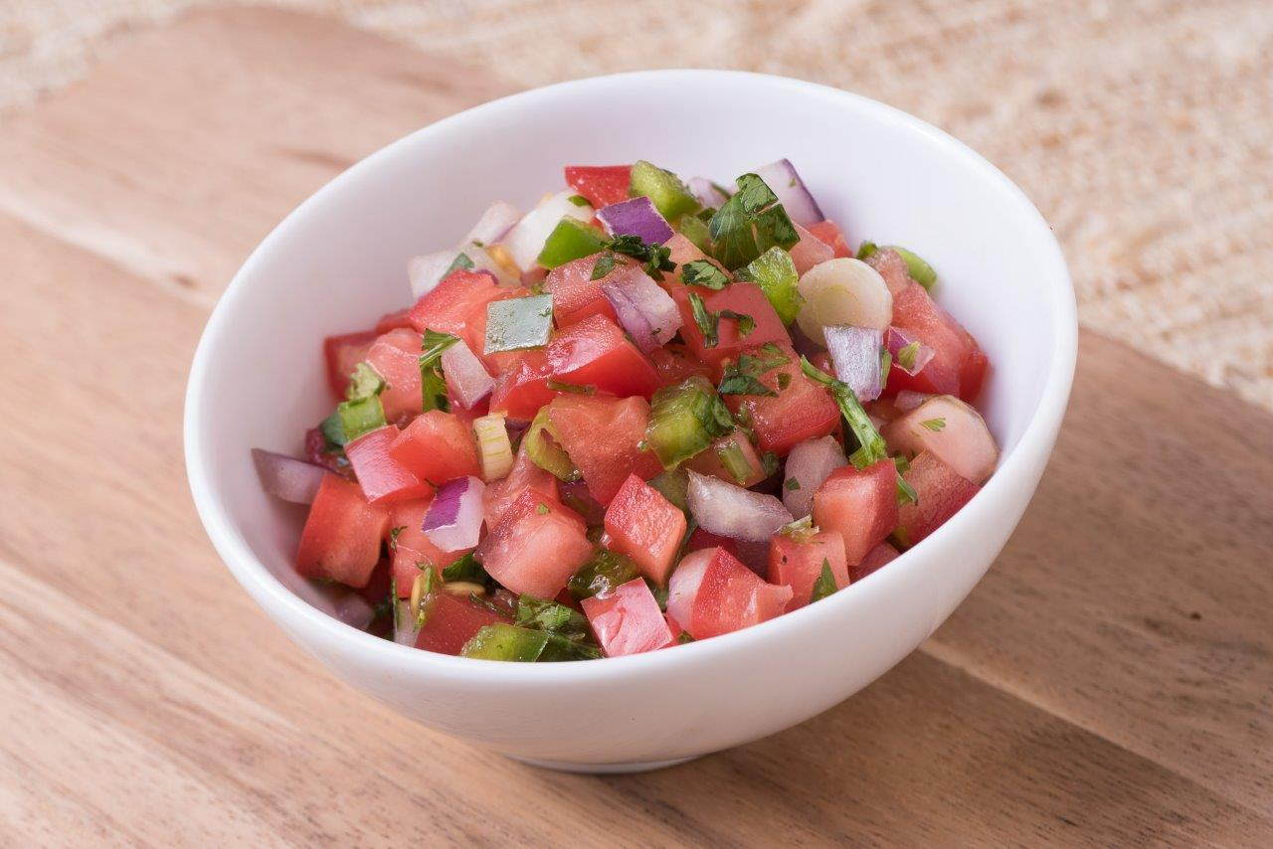

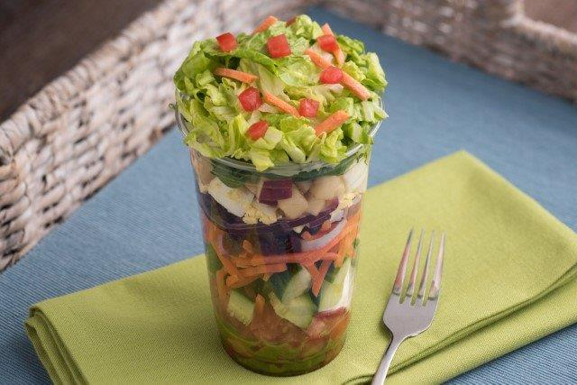

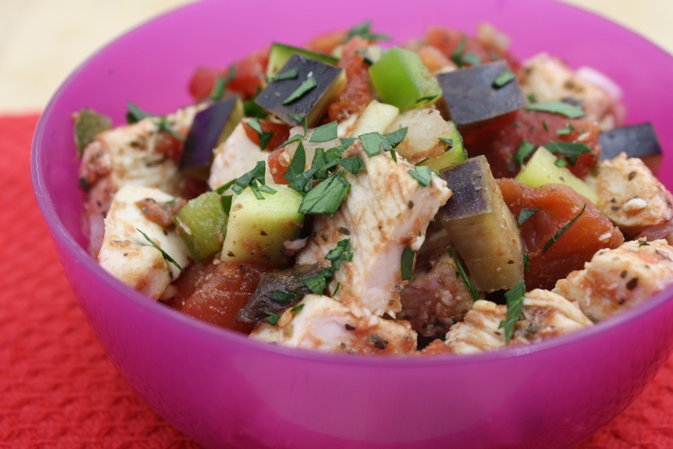
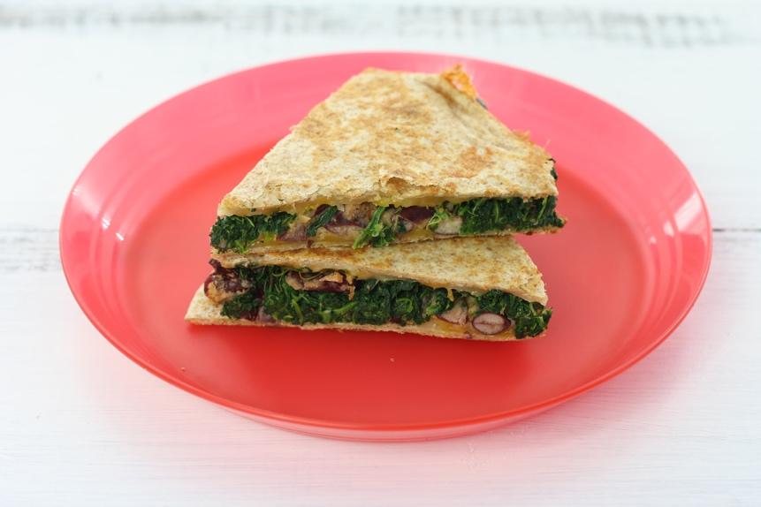
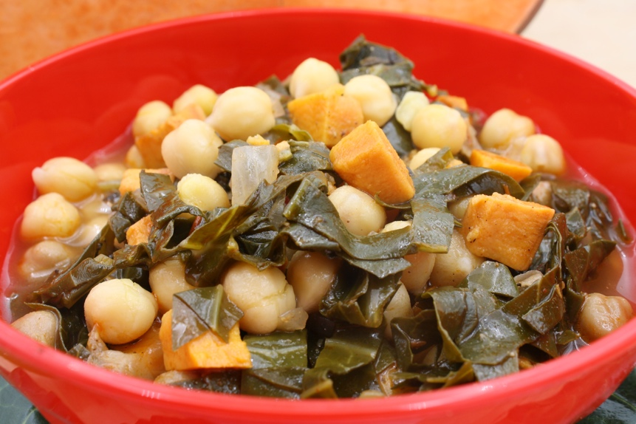
Vegetable Recipes for the CACFP
theicn.org/cnrb/
Notes:
Many of the vegetable recipes shown on the slides today come from USDA’s standardized recipes collection, with some of the recipes created specifically for the CACFP. All of these recipes include crediting information and are available in yields of 25 and 50 servings. Some of the recipes are also available in yields of 6 servings. The recipes shown on the screen and many more can be found on the Child Nutrition Recipe Box by using the web address on the screen.

Slide 40
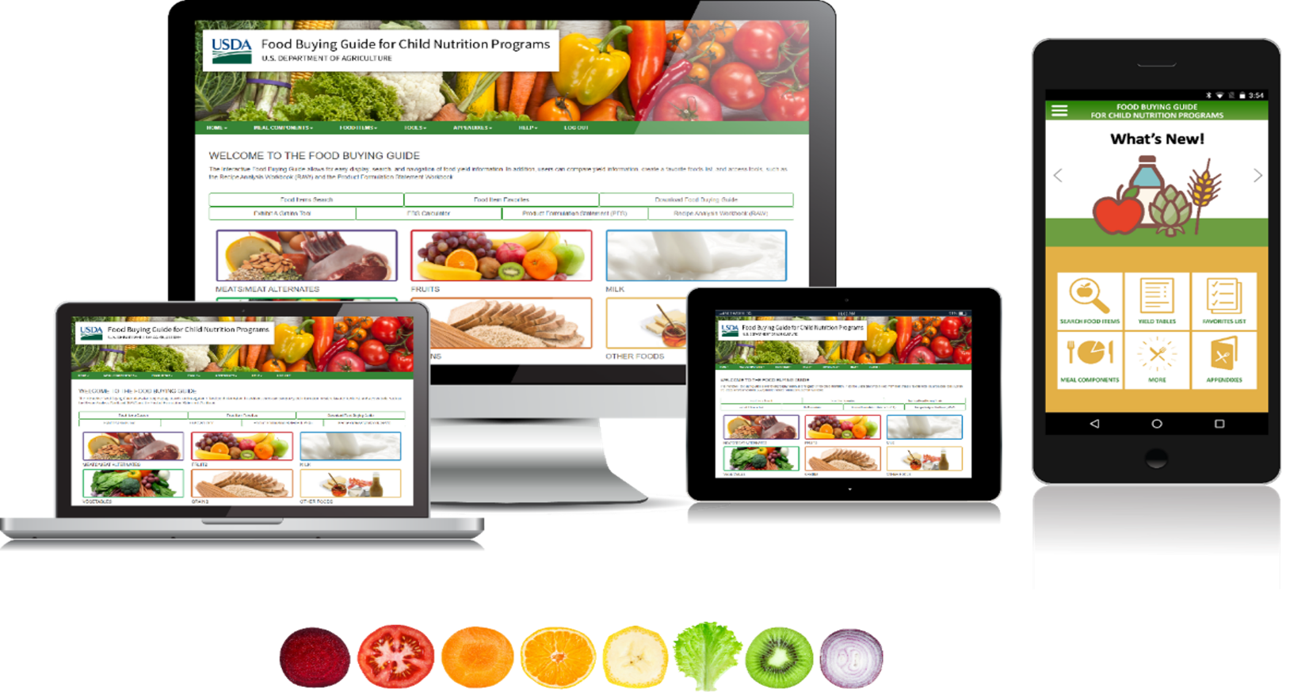
Food Buying Guide
fns.usda.gov/tn/fbg
Notes:
For those of you who may need assistance with crediting your favorite recipes, I want to highlight the Food Buying Guide for Child Nutrition Programs (or FBG).
The FBG helps Program operators determine how much of a food item to purchase and how it counts toward the meal pattern requirements.
The FBG is your go-to resource for determining if a food is creditable – if you are not already familiar with it, please plan to spend time exploring this valuable tool.
This resources is available as a downloadable PDF, interactive Web-based Tool, and Mobile App for smartphones and tablets.

Slide 41
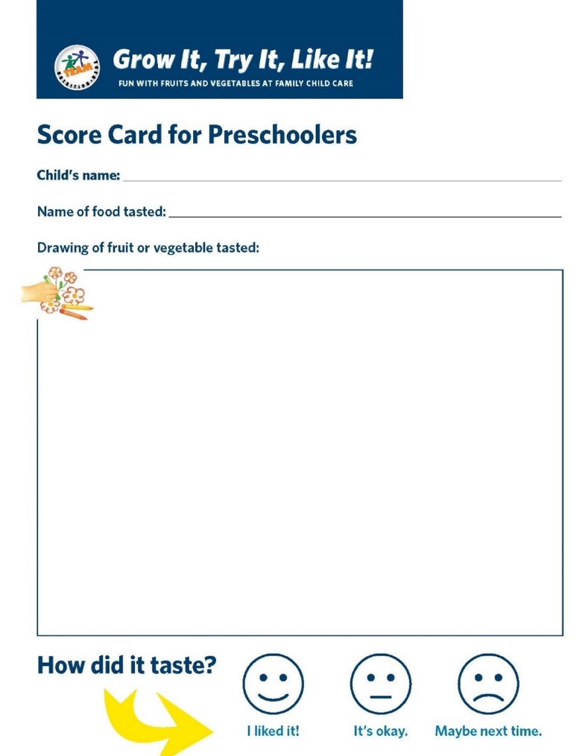
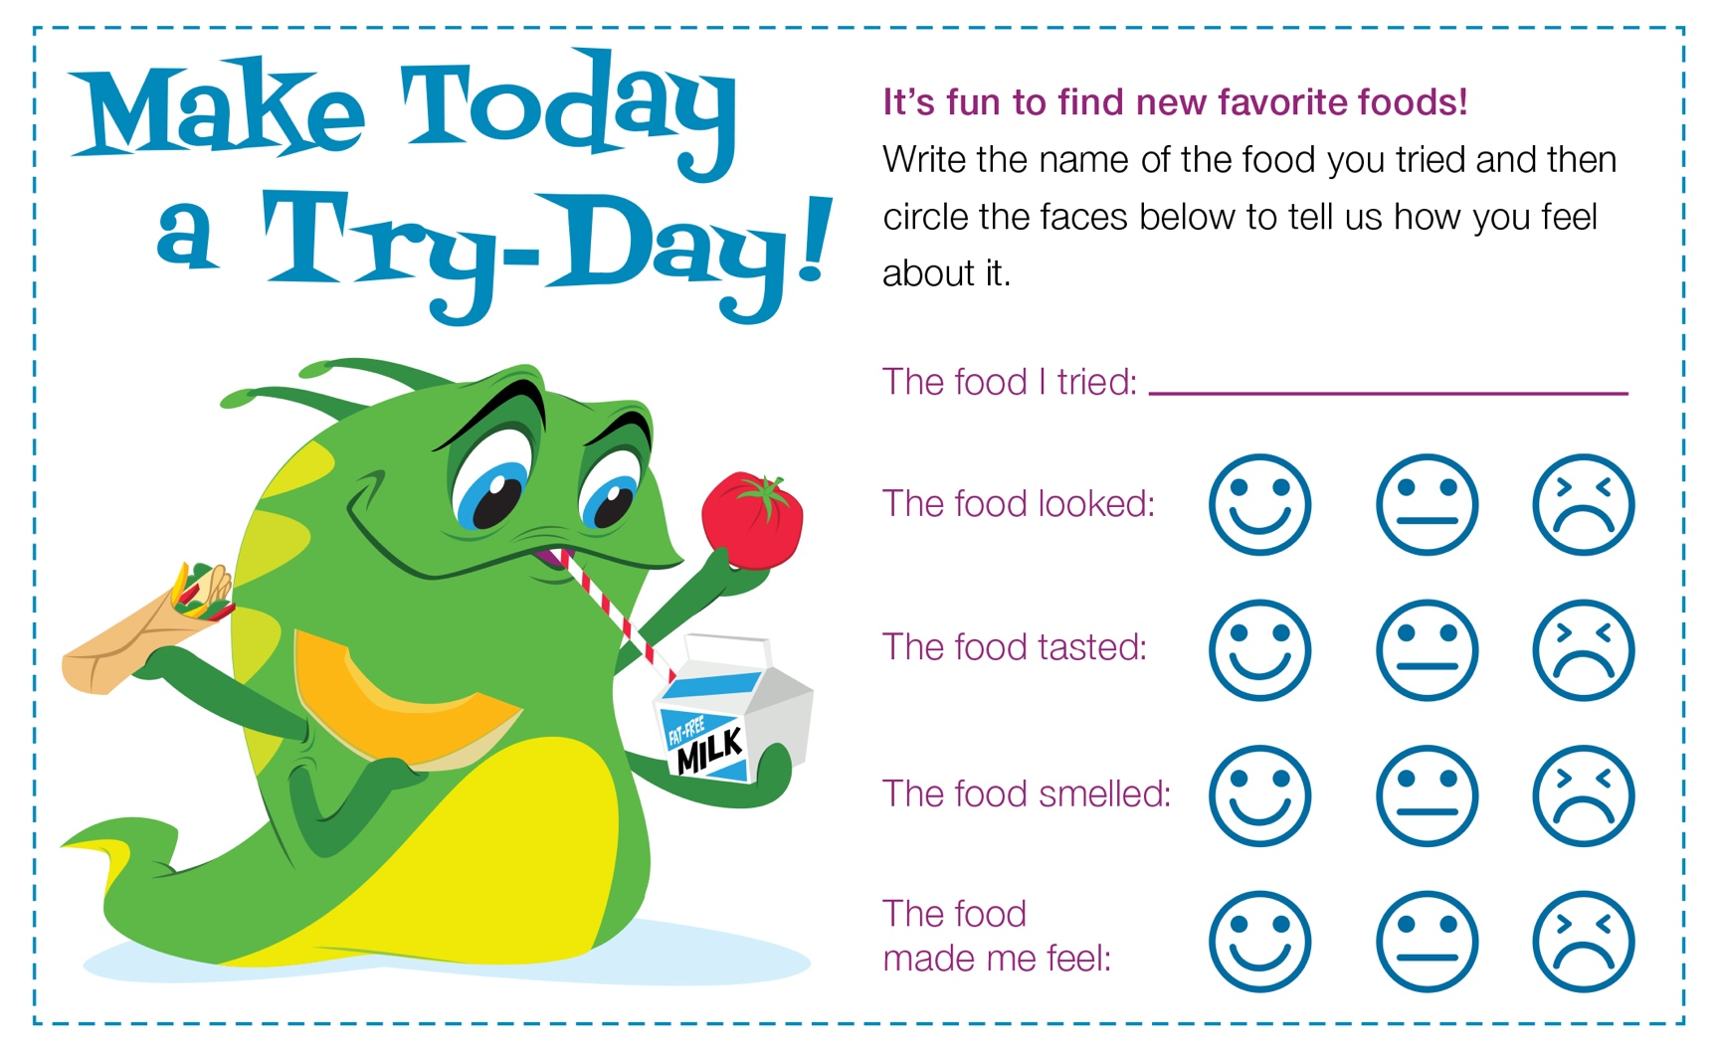
Try Days
fns.usda.gov/teamnutrition
Notes:
Now, recipes and trying new foods sometimes go hand in hand. We know that getting children to try vegetables may be a challenge. Young children may need to see a new food, including vegetables, ten or more times before accepting it. Some child care operators have had success with Try-Day Fridays or Tasting Tuesdays, where children can try new vegetables, or vegetables prepared in different ways, and can rate how they felt about them.
Team Nutrition has two different taste-testing ballots that you can download and print.
.

Slide 42

Seasonal Vegetables for Try-Days
Try Day stickers at:
fns.usda.gov/teamnutrition
Notes:
Page 4 of the worksheet includes a chart of when certain vegetables might be in season throughout the year. You can use this chart to help you choose foods for Try-Day Fridays, or any other tasting event!

Slide 43
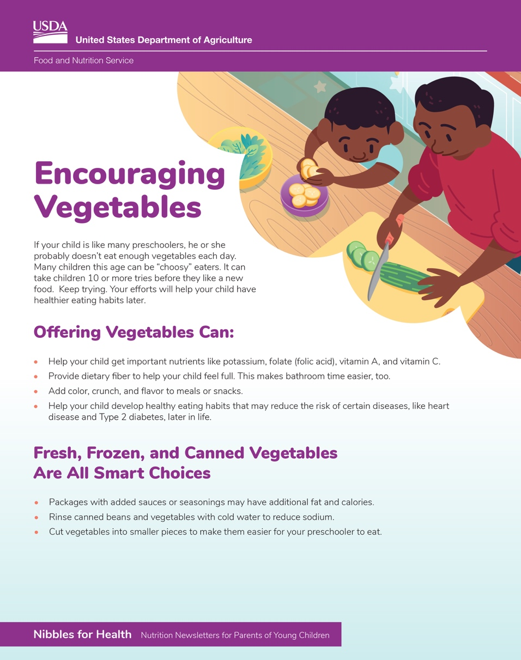
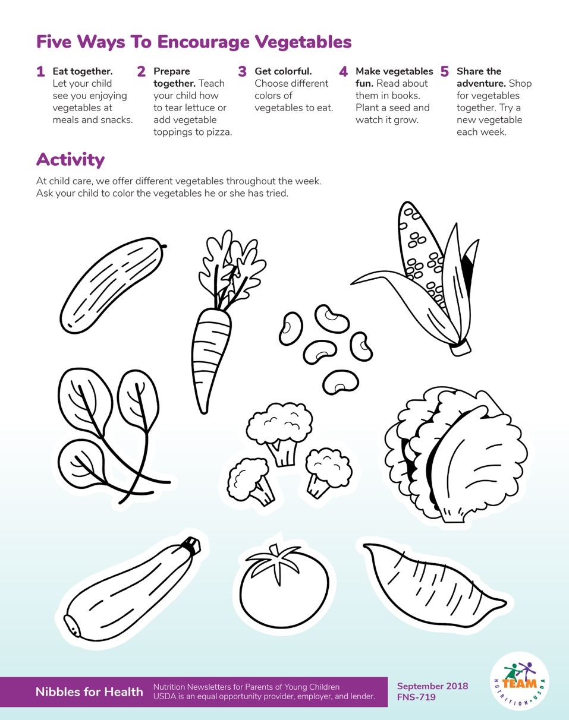
Nibbles for Health Newsletters
fns.usda.gov/teamnutrition
Notes:
Additionally, to promote healthy eating when children are at home, Team Nutrition’s Nibbles for Health Newsletters are available for child care providers to share information with parents and families. This collection includes a newsletter on Encouraging Vegetables and it is available online.

Slide 44

Crediting Tip Sheets
fns.usda.gov/tn/cn/crediting-tipsheets
Notes:
Finally, Child Nutrition Program operators now have access to convenient crediting tip sheets that explain how to credit each of the five meal components across all Child Nutrition Programs. Each sheet offers straightforward, easy-to-use guidance for a specific meal component, including three separate sheets dedicated to grains. These resources are designed to support accurate crediting in every program.
If you're not familiar with these tip sheets, we recommend reviewing them after the training.

Slide 45
Frequently Asked Question 1
Q: If I put vegetable juice in a smoothie, can I count that vegetable juice toward the vegetable component?
Notes:
Now, that concludes the informational portion of this training, but we want to share a few frequently asked questions on this topic.
The first question we have is, if I put vegetable juice in a smoothie can I count that vegetable juice count as a vegetable?

Slide 46
Frequently Asked Question 1 and Answer
Q: If I put vegetable juice in a smoothie, can I count that vegetable juice toward the vegetable component?
A: Yes, vegetable juice or pureed vegetables used in a smoothie can count toward the vegetables component in the CACFP. Remember that juice can be served only once per day in the CACFP. So, if you served a smoothie that has vegetable juice or pureed vegetables, and you want to count the juice as part of the reimbursable meal or snack, then you may not serve any kind of juice, whether it’s vegetable juice or fruit juice, as part of another reimbursable CACFP meal or snack that day.
Notes:
A: Yes, vegetable juice or pureed vegetables used in a smoothie can count toward the vegetables component in the CACFP. Remember that juice can be served only once per day in the CACFP. So, if you served a smoothie that has vegetable juice or pureed vegetables, and you want to count the juice as part of the reimbursable meal or snack, then you may not serve any kind of juice, whether it’s vegetable juice or fruit juice, as part of another reimbursable CACFP meal or snack that day.

Slide 47
Frequently Asked Question 2
Q: Do vegetable noodles, like zucchini noodles, count as vegetables?
Notes:
The next question is, do vegetable noodles, like zucchini noodles, count as vegetables?

Slide 48
Frequently Asked Question 2 and Answer
Q: Do vegetable noodles, like zucchini noodles, count as vegetables?
A: Vegetables cut into the shape of noodles or spirals, such as carrot noodles or zucchini noodles, can count toward the vegetable component in the CACFP. Dry pasta made of 100% vegetable flours, such as lentil flour pasta or chickpea flour pasta, credit towards the vegetable requirements. For more information, please contact your State Agency or sponsoring organization and the Food Buying Guide for Child Nutrition Programs.
Notes:
A. Vegetables cut into the shape of noodles or spirals, such as carrot noodles or zucchini noodles, can count toward the vegetable component in the CACFP. Dry pasta made of 100% vegetable flours, such as lentil flour pasta or chickpea flour pasta, credits toward the vegetable requirements. For more information, please contact your State Agency or sponsoring organization and the Food Buying Guide for Child Nutrition Programs.

Slide 49
Frequently Asked Question 3
Q: Are there resources available that can help me determine which vegetables are creditable in the CACFP?
Notes:
Another common question is, are there resources available that can help me determine which vegetables are creditable in the CACFP?

Slide 50
Frequently Asked Question 3 and Answer
Q: . Are there resources available that can help me determine which vegetables are creditable in the CACFP?
A: Yes, a popular resource is the Crediting Handbook for the Child and Adult Care Food Program. This resource explains which foods are creditable in the CACFP and how they count toward meal pattern requirements. It gives guidance on what forms of vegetables are allowed (fresh, frozen, canned, dried), how mixed dishes credit, and general program guidance. This resource is a companion piece to the Food Buying Guide for Child Nutrition Programs, the primary tool programs use to determine whether a vegetable is creditable in CACFP.
Notes:
A: Yes, a popular resource is the Crediting Handbook for the Child and Adult Care Food Program. This resource explains which foods are creditable in the CACFP and how they count toward meal pattern requirements. It gives guidance on what forms of vegetables are allowed (fresh, frozen, canned, dried), how mixed dishes credit, and general program guidance. This resource is a companion piece to the Food Buying Guide for Child Nutrition Programs, the primary tool programs use to determine whether a vegetable is creditable in CACFP.

Slide 51
Frequently Asked Question 4
Q: Can I serve the same vegetable multiple times a week?
Notes:
The next question is, can I serve the same vegetable multiple times a week?

Slide 52
Frequently Asked Question 4 and Answer
Q: Can I serve the same vegetable multiple times a week?
A: Yes. The CACFP does not limit how often a vegetable can be served. However, as best practice program operators are encouraged to serve a variety of vegetables throughout the week. The Dietary Guidelines for Americans emphasize consuming a wide variety of colorful, nutrient-dense vegetables in their whole forms throughout the day.
Notes:
A: Yes. CACFP does not limit how often a vegetable can be served. However, as best practice program operators are encouraged to serve a variety of vegetables throughout the week. The Dietary Guidelines for Americans emphasize consuming a wide variety of colorful, nutrient-dense vegetables in their whole forms throughout the day.

Slide 53
Frequently Asked Question 5
Q: I usually serve carrots, peas, corn, and potatoes. What are other vegetables that kids will eat?
Notes:
And the last question we have time for is, I usually serve carrots, peas, corn and potatoes. What are other vegetables that kids will eat?

Slide 54
Frequently Asked Question 5 and Answer
Q: I usually serve carrots, peas, corn, and potatoes. What are other vegetables that kids will eat?
A: Yes. The CACFP does not limit how often a vegetable can be served. However, as best practice program operators are encouraged to serve a variety of vegetables throughout the week. The Dietary Guidelines for Americans emphasize consuming a wide variety of colorful, nutrient-dense vegetables in their whole forms throughout the day.
Notes:
A: Yes. CACFP does not limit how often a vegetable can be served. However, as best practice program operators are encouraged to serve a variety of vegetables throughout the week. The Dietary Guidelines for Americans emphasize consuming a wide variety of colorful, nutrient-dense vegetables in their whole forms throughout the day.

Slide 55

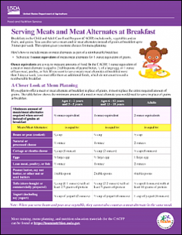
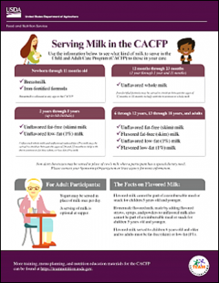
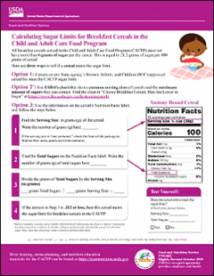
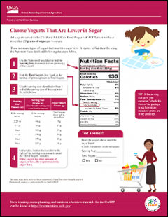
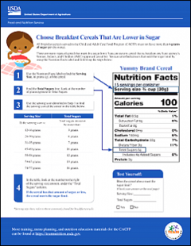
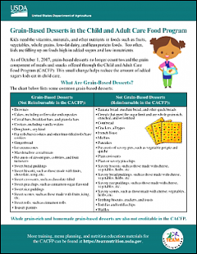
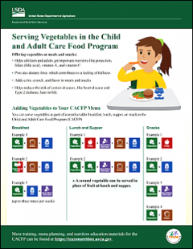
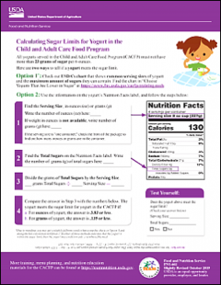
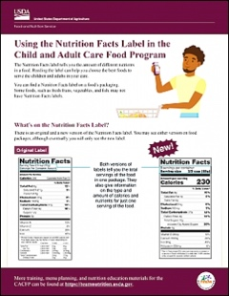
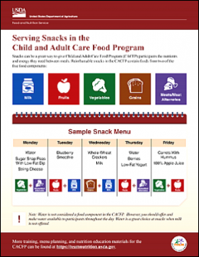
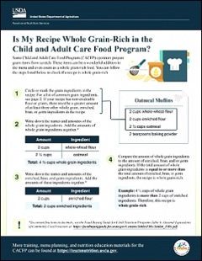

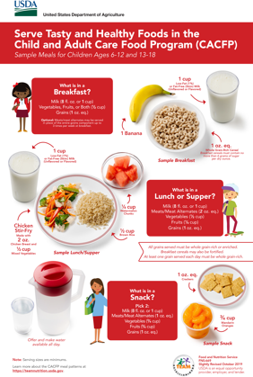


Additional Resources!
fns.usda.gov/teamnutrition
Notes:
All Team Nutrition materials are available online from Team Nutrition’s website and are available for free download to anybody who is interested.

Slide 56


Stay Connected!
fns.usda.gov/teamnutrition
TeamNutrition@usda.gov
USDA is an equal opportunity provider, employer, and lender.
Notes:
These training slides were provided by U.S. Department of Agriculture's Team Nutrition. If you would like to learn more about Team Nutrition and additional resources available, please visit the website, subscribe to the e-newsletter, or connect with us via email at teamnutrition@usda.gov.

Slide 57
Thank you!
Visit us at
FNS.USDA.GOV | @USDA_FNS | @USDA
Notes:
Also, you can stay connected with USDA via Facebook, X, Instagram, and YouTube.
Thank you for taking this training!

