Slide 1

Serving Meats and Meat Alternates at Breakfast
A Training Presentation for
Child and Adult Care Food Program (CACFP) Operators
Guidance documents lack the force and effect of law, unless expressly authorized by statute or incorporated into a contract. USDA may not cite, use, or rely on any guidance that is not available through their guidance portal, except to establish historical facts.
Notes:
Hi! This webinar focuses on the USDA’s Team Nutrition worksheet titled “Serving Meats and Meat Alternates at Breakfast in the Child and Adult Care Food Program.” For the remainder of this session, we will refer to the program as the CACFP.

Slide 2
Guidance Disclaimer
Guidance documents lack the force and effect of law, unless expressly authorized by statute or incorporated into a contract. USDA may not cite, use, or rely on any guidance that is not available through their guidance portal, except to establish historical facts.
Notes:
Please note that the USDA can only use guidance that is posted on its official guidance portal, and anything not posted there may be referenced only to show historical context. Now let’s get started.

Slide 3
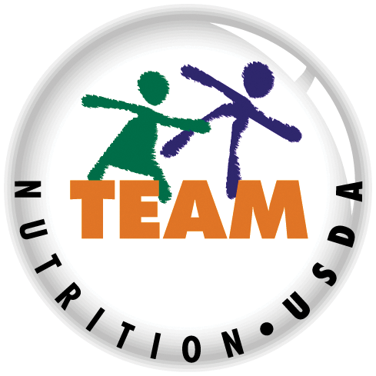
USDA’s Team Nutrition
An initiative of the USDA’s Food and Nutrition Administration to support the USDA’s Child Nutrition Programs.
Aims to improve children’s lifelong eating and physical activity habits.
Provides nutrition education and training materials to State agencies, sponsoring organizations, and CACFP sites.
fna.usda.gov/teamnutrition
Guidance documents lack the force and effect of law, unless expressly authorized by statute or incorporated into a contract. USDA may not cite, use, or rely on any guidance that is not available through their guidance portal, except to establish historical facts.
Notes:
Team Nutrition is an initiative of the USDA Food and Nutrition Administration that supports the Child Nutrition Programs, including the National School Lunch Program, the School Breakfast Program, and of course, the Child and Adult Care Food Program, or the CACFP.
The goal of Team Nutrition is to improve children's lifelong eating and physical activity habits through nutrition education based on the principles of the Dietary Guidelines for Americans and the Real Food Pyramid.
It does so through training and technical assistance for those preparing and serving meals, providing nutrition education for children, and building support for healthier school and child care environments.

Slide 4
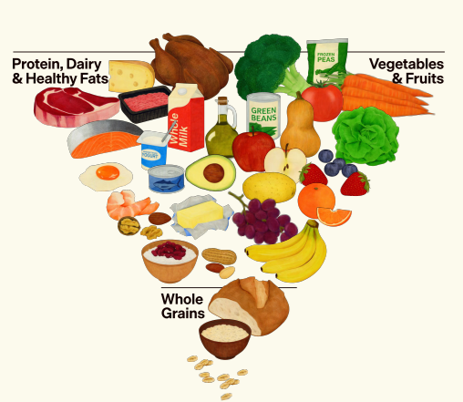
The Real Food Pyramid
realfood.gov
Guidance documents lack the force and effect of law, unless expressly authorized by statute or incorporated into a contract. USDA may not cite, use, or rely on any guidance that is not available through their guidance portal, except to establish historical facts.
Notes:
When planning your CACFP menus, follow the Dietary Guidelines for Americans and the Real Food Pyramid’s recommendations to eat high-quality, nutrient-dense protein foods as part of a healthy dietary pattern.
For more information about the Dietary Guidelines and the Real Food Pyramid go to the web address shown on the slide, realfood.gov. Now let’s get started.

Slide 5
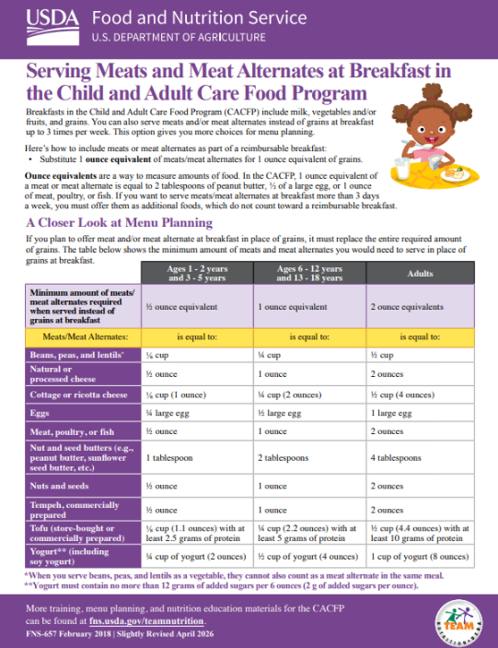
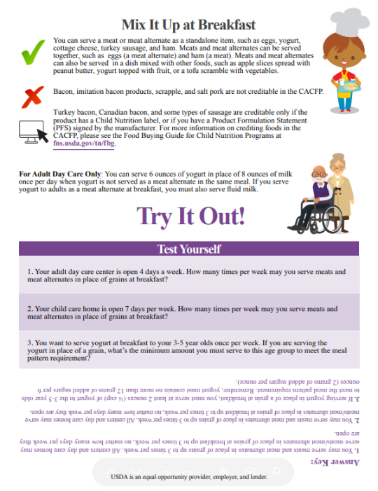


Serving Meats and Meat Alternates at Breakfast in the CACFP
So, lets get started! As you can see on the screen, today we will discuss how you can serve Meat and Meat Alternates as part of a reimbursable breakfast in the CACFP.
You can download Team Nutrition’s training worksheet on this topic at the web address listed on the screen.
fna.usda.gov/tn/cacfp/meal-pattern-training-worksheets
Guidance documents lack the force and effect of law, unless expressly authorized by statute or incorporated into a contract. USDA may not cite, use, or rely on any guidance that is not available through their guidance portal, except to establish historical facts.
Notes:
Let's get started! As you can see on the screen, today we will discuss how you can serve Meats and Meat Alternates as part of a reimbursable breakfast in the CACFP.
You can download Team Nutrition’s training worksheet on this topic by scanning the QR code or visiting the web address listed on the screen. It is helpful to have the worksheet handy during the webinar.

Slide 6
Serving Meat and Meat Alternates at Breakfast
A reimbursable breakfast includes milk, vegetables and/or fruits, and grains.
You can also serve meats and/or meat alternates instead of grains at breakfast up to 3 times per week.
This option gives you more choices for menu planning.
Guidance documents lack the force and effect of law, unless expressly authorized by statute or incorporated into a contract. USDA may not cite, use, or rely on any guidance that is not available through their guidance portal, except to establish historical facts.
Notes:
The top of the worksheet states the requirements for a reimbursable breakfast in the CACFP as well as the flexibility to serve meats and meat alternates in place of grains up to 3 times per week.

Slide 7
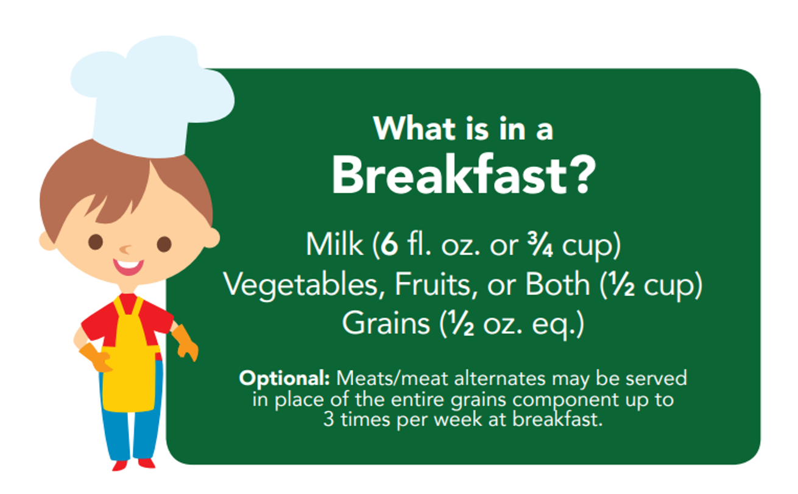
Breakfast Requirements for 3–5 Year Olds
Guidance documents lack the force and effect of law, unless expressly authorized by statute or incorporated into a contract. USDA may not cite, use, or rely on any guidance that is not available through their guidance portal, except to establish historical facts.
Notes:
For each meal component, there is a minimum amount that must be served for the food to be counted as part of a reimbursable meal. For instance, at breakfast, children 3 through 5 years old must receive at least:
6 fluid ounces, or ¾ cup, of milk;
½ cup of vegetables, fruit, or both, and
½ ounce equivalent of grains.
You also have the option to serve creditable meats and/or meat alternates in place of grains at breakfast up to three times per week. As many of you know, meats and meat alternates are foods such as eggs, ham, turkey, nut butters, yogurt, cheese, cottage cheese, tofu, and beans, just to name a few.
When using this flexibility, the amount of meats and meat alternates provided must be equal to or greater than the amount of grains required for the age group being served.

Slide 8
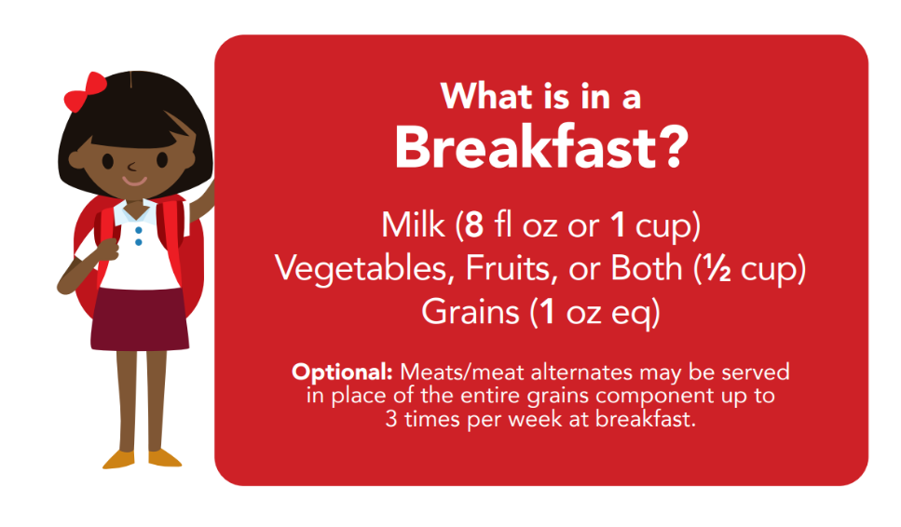
Breakfast Requirements for 6−18 Year Olds
Guidance documents lack the force and effect of law, unless expressly authorized by statute or incorporated into a contract. USDA may not cite, use, or rely on any guidance that is not available through their guidance portal, except to establish historical facts.
Notes:
Another example might be that for 6 through 12 and 13 through 18-year-olds you serve at least:
8 fluid ounces, or 1 cup, of milk;
½ cup of vegetables, fruit, or both, and
1 ounce equivalent of grains.
You also have the option to serve creditable meats and/or meat alternates in place of grains at breakfast up to three times per week. As many of you know, meats and meat alternates are foods such as eggs, ham, turkey, nut butters, yogurt, cheese, cottage cheese, tofu, and beans, just to name a few.
When using this flexibility, the amount of meats and meat alternates provided must be equal to or greater than the amount of grains required for the age group being served.

Slide 9

Breakfast Requirements for 3−5 Year Olds
What is in a
Breakfast?
Milk (6 fl. oz. or ³/₄ cup)
Vegetables, Fruit, or Both (¹/₂ cup)
Grains (¹/₂ oz. eq.)
Optional: Meat/meat alternates may be served in place of the entire grains component up to
3 times per week at breakfast.
What is in a
Breakfast?
Milk (6 fl. oz. or ³/₄ cup)
Vegetables, Fruit, or Both (¹/₂ cup)
Meats/Meat Alternate (¹/₂ oz. eq.)
Up to 3 times per week
Guidance documents lack the force and effect of law, unless expressly authorized by statute or incorporated into a contract. USDA may not cite, use, or rely on any guidance that is not available through their guidance portal, except to establish historical facts.
Notes:
If you wanted to serve meats or meat alternates at breakfast to your 3 through five year olds, you would keep the ¾ cup of milk, the ½ cup of vegetables and/or fruit, and then serve a ½ oz. equivalent of meats/meat alternates instead of a grain.
Because the meat or meat alternate is replacing the grain, you do not have to serve a grain. You can use this flexibility up to three times per week, no matter how many days your center or home is open.
Whether your site is open three days per week or seven days per week, you may serve meats/meat alternates in place of grains at breakfast up to three times per wee

Slide 10


Try It Out #1!
?
To serve a meat or meat alternate in place of grains at breakfast for 6−12 year olds, what is the minimum amount you must serve?
8 oz
½ oz eq
1 oz eq
2 oz eq
What is in a
Breakfast?
Milk (8 fl. oz. or 1 cup)
Vegetables, Fruit, or Both (¹/₂ cup)
Grains (1 oz. eq.)
Optional: Meats/meat alternates may be served in
place of the entire grains component up to
3 times per week at breakfast.
Guidance documents lack the force and effect of law, unless expressly authorized by statute or incorporated into a contract. USDA may not cite, use, or rely on any guidance that is not available through their guidance portal, except to establish historical facts.
Notes:
Let's apply what we just learned with a practice question!
A reimbursable breakfast for 6 through 12 year olds in the CACFP must contain:
8 fluid ounces/1 cup of milk,
½ cup vegetables, fruit, or both, and
1 oz eq grains.
To serve a meat or meat alternate in place of grains at breakfast for 6−12 year olds, what is the minimum amount you must serve?
Raise your hand if you think the minimum serving size is:
8 ounces [pause and wait for a show of hands],
½ ounce equivalent [pause and wait for a show of hands],
1 ounce equivalent [pause and wait for a show of hands], or
2 ounce equivalents.

Slide 11
Answer #1
To serve a meat or meat alternate in place of grains at breakfast for 6−12 year olds, what is the minimum amount you must serve?
8 oz
½ oz eq
1 oz eq
2 oz eq
What is in a
Breakfast?
Milk (8 fl. oz. or 1 cup)
Vegetables, Fruit, or Both (¹/₂ cup)
Grains (1 oz. eq.)
Optional: Meat/meat alternates may be served in
place of the entire grains component up to
3 times per week at breakfast.
Guidance documents lack the force and effect of law, unless expressly authorized by statute or incorporated into a contract. USDA may not cite, use, or rely on any guidance that is not available through their guidance portal, except to establish historical facts.
Notes:
Nice work everyone! If you said C, 1 ounce equivalent, you are correct. You must serve at least 1 ounce equivalent of a meat or meat alternate at breakfast to 6 through 12 year olds if you are serving it in place of grains as part of a reimbursable breakfast. When you use the flexibility to replace the grains component with meats/meat alternates at breakfast, you must serve an amount equal to or greater than the amount of grains required for that meal.

Slide 12
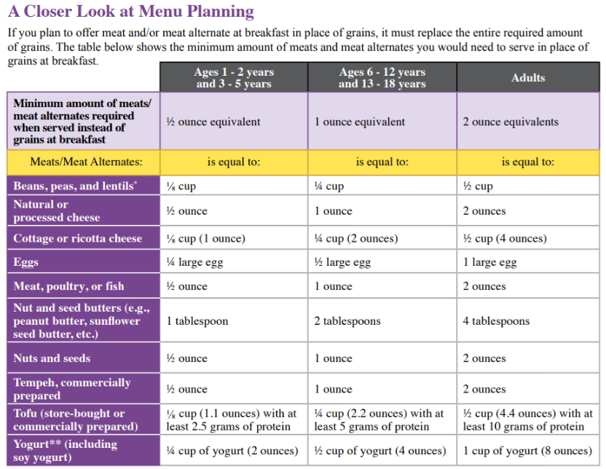
How much do you need to serve?
Guidance documents lack the force and effect of law, unless expressly authorized by statute or incorporated into a contract. USDA may not cite, use, or rely on any guidance that is not available through their guidance portal, except to establish historical facts.
Notes:
Now, let’s take a closer look at how much of a certain food makes up a ½ ounce equivalent, 1 ounce equivalent, or 2 ounce equivalents of meats or meat alternates.
As you see on the screen, the bottom half of the worksheet has a table that lists common meats or meat alternates that might be served at breakfast, such as cheese, eggs, etc., in the far left column. Across the top you will find the different age groups for the child and adult meals in the CACFP and below that is the minimum serving size requirement at breakfast for the age group.

Slide 13
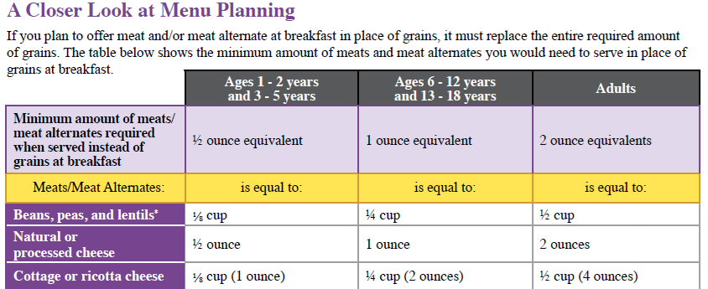
A Closer Look at Menu Planning: Ages & Amounts
Guidance documents lack the force and effect of law, unless expressly authorized by statute or incorporated into a contract. USDA may not cite, use, or rely on any guidance that is not available through their guidance portal, except to establish historical facts.
Notes:
For example, if you look at the column that has a yellow rectangle, you will see that this column is for the age groups of 1-2 and 3-5 years of age.

Slide 14
A Closer Look at Menu Planning: How Much
Guidance documents lack the force and effect of law, unless expressly authorized by statute or incorporated into a contract. USDA may not cite, use, or rely on any guidance that is not available through their guidance portal, except to establish historical facts.
Notes:
The light purple at the top tells you that the minimum serving size for meat and meat alternates for ages 1 through 5 years is ½ ounce equivalent.

Slide 15
A Closer Look at Menu Planning: How Much for Ages 1 Though 5 Years
Guidance documents lack the force and effect of law, unless expressly authorized by statute or incorporated into a contract. USDA may not cite, use, or rely on any guidance that is not available through their guidance portal, except to establish historical facts.
Notes:
The information directly below the age group tells you how much of a food is needed to provide ½ ounce equivalent of meats/meat alternates food component.
You can see that ⅛ cup of beans, ½ ounce of natural or processed cheese, or an ⅛ cup of cottage or ricotta cheese, are all equal to ½ ounce equivalent of meat or meat alternate.

Slide 16

Try It Out #2!
If you serve cottage cheese at breakfast in place of grains, to your 3−5 year olds, how much cottage cheese do you need to serve?
?
⅛ cup
¼ cup
1 Tbsp
½ Tbsp
Guidance documents lack the force and effect of law, unless expressly authorized by statute or incorporated into a contract. USDA may not cite, use, or rely on any guidance that is not available through their guidance portal, except to establish historical facts.
Notes:
Let’s do a practice question!
Take a look at the table on the worksheet and find the row with cottage cheese on it.
If you serve cottage cheese at breakfast in place of grains, to your 3 through 5 year olds, how much yogurt do you need to serve?
Raise your hand if you think you need to serve at least:
⅛ cup of yogurt [pause and wait for a show of hands],
¼ cup of yogurt [pause and wait for a show of hands],
1 tablespoon of yogurt [pause and wait for a show of hands], or
½ tablespoon of yogurt.

Slide 17
Answer #2
If you serve cottage cheese at breakfast in place of grains, to your 3−5 year olds, how much cottage cheese do you need to serve?
⅛ cup
¼ cup
1 Tbsp
½ Tbsp
Guidance documents lack the force and effect of law, unless expressly authorized by statute or incorporated into a contract. USDA may not cite, use, or rely on any guidance that is not available through their guidance portal, except to establish historical facts.
Notes:
Nice work everyone! If you said A, ⅛ cup you are correct. If you want to serve cottage cheese in place of a grain as part of a reimbursable breakfast in the CACFP, and you are serving 3 through 5 year olds, you need to serve at least ⅛ cup, or 1 ounce, of cottage cheese.

Slide 18
A Closer Look at Menu Planning: How Much for Ages 6 Through 18 Years
Guidance documents lack the force and effect of law, unless expressly authorized by statute or incorporated into a contract. USDA may not cite, use, or rely on any guidance that is not available through their guidance portal, except to establish historical facts.
Notes:
The column next to the 1-2 and 3-5 year olds talks about requirements for the 6-12 and 13-18 year old age group.
You can see in the light purple box at the top that the minimum amount of meat or meat alternate needed is 1 ounce equivalent, and that ¼ cup of beans, 1 ounce of cheese, ¼ cup of cottage cheese or ricotta cheese, etc. are equal to 1 ounce equivalent of meat/meat alternates.

Slide 19

Try It Out #3!
?
If you serve peanut butter in place of grains at breakfast, to your 6–12 year olds, how much do you need to serve?
1 Tbsp
¼ Tbsp
2 Tbsp
½ Tbsp
Guidance documents lack the force and effect of law, unless expressly authorized by statute or incorporated into a contract. USDA may not cite, use, or rely on any guidance that is not available through their guidance portal, except to establish historical facts.
Notes:
Let’s try another practice question. If you have the worksheet available, look at the table and find the row with peanut butter on it.
If you serve peanut butter in place of grains at breakfast to your 6 through 12 years olds, how much peanut butter do you need to serve?
A. 1 Tbsp,
B ¼ Tbsp,
C. 2 Tbsp, or
D. ½ Tbsp of peanut butter.

Slide 20
Answer #3
If you serve peanut butter in place of grains at breakfast, to your 6–12 year olds, how much do you need to serve?
1 Tbsp
¼ Tbsp
2 Tbsp
½ Tbsp
Guidance documents lack the force and effect of law, unless expressly authorized by statute or incorporated into a contract. USDA may not cite, use, or rely on any guidance that is not available through their guidance portal, except to establish historical facts.
Notes:
If you said C, 2 Tbsp, you are correct. As the table shows, you would need to serve at least 2 tablespoons of peanut butter if you are serving it in place of grains at breakfast to children 6-12 years of age.

Slide 21
A Closer Look at Menu Planning: How Much for Adults
Guidance documents lack the force and effect of law, unless expressly authorized by statute or incorporated into a contract. USDA may not cite, use, or rely on any guidance that is not available through their guidance portal, except to establish historical facts.
Notes:
The last column gives information for adults, stating that the minimum amount of meat/meat alternate required when its replacing grains at breakfast is 2 ounce equivalents.
Half a cup of beans or peas, 2 ounces of natural or processed cheese, ½ cup of cottage and ricotta cheese, etc. are all equal to 2 ounce equivalents of meat/meat alternates.

Slide 22
Try It Out #4!
?
You work for an adult day care site, and you would like to serve them eggs for breakfast twice per week. How much egg do you need to serve if you are serving them in place of grains?
¼ large egg
½ large egg
½ tablespoon large egg
1 large egg
Guidance documents lack the force and effect of law, unless expressly authorized by statute or incorporated into a contract. USDA may not cite, use, or rely on any guidance that is not available through their guidance portal, except to establish historical facts.
Notes:
Let’s practice again!
Take a look at the chart on your worksheet, find row with eggs on it. How much egg do you need to serve an adult if you are serving it in place of a grain at breakfast?
Your options are:
¼ of a large egg
½ a large egg
½ tablespoon large egg, or
1 large egg.

Slide 23
Answer #4
You work for an adult day care site, and you would like to serve them eggs for breakfast twice per week. How much egg do you need to serve if you are serving them in place of grains?
¼ large egg
½ large egg
½ tablespoon large egg
1 large egg
Guidance documents lack the force and effect of law, unless expressly authorized by statute or incorporated into a contract. USDA may not cite, use, or rely on any guidance that is not available through their guidance portal, except to establish historical facts.
Notes:
If you said D, 1 large egg you are correct. As the table shows, you would need to serve at least 1 large egg if you are serving it in place of grains at breakfast to adult participants.

Slide 24
Serving Beans, Peas, and Lentils
When you serve beans, peas, and lentils as a vegetable, they cannot also count as a meat alternate in the same meal.
As of October 1, 2025, yogurt must contain no more than 12 grams of added sugars per 6 ounces (2 g of added sugars per ounce).
Guidance documents lack the force and effect of law, unless expressly authorized by statute or incorporated into a contract. USDA may not cite, use, or rely on any guidance that is not available through their guidance portal, except to establish historical facts.
Notes:
One more note before we move to the second page of the worksheet. As stated at the bottom of the worksheet—if you are serving beans, peas, and lentils to fulfill the vegetable/fruit component at breakfast, then you cannot also count it as a meat alternate in the same meal. You must decide which component you want your beans, peas, and lentils to meet, and then serve milk and the other required component to have a reimbursable meal.
Also note that as of October 1, 2025, yogurt must contain no more than 12 grams of added sugars per 6 ounces.

Slide 25
Mix It Up at Breakfast
✓ You can serve a meat or meat alternate as a standalone item, such as eggs, yogurt, cottage cheese, turkey sausage, and ham. Meats and meat alternates can be served together, such as eggs (a meat alternate) and ham (a meat). Meats and meat alternates can also be served in a dish mixed with other foods, such as apple slices spread with peanut butter, yogurt topped with fruit, or a tofu scramble with vegetables.
X Bacon, imitation bacon products, scrapple and salt pork are not creditable in the CACFP.
Turkey bacon, Canadian bacon, and some types of sausage are creditable only if they product has a Child Nutrition label, or if you have a Product Formulation Statement (PFS) signed by the manufacturer. For more information on crediting foods in the CACFP, please see the Food Buying Guide for Child Nutrition Programs at fna.usda.gov/tn/fbg.
Guidance documents lack the force and effect of law, unless expressly authorized by statute or incorporated into a contract. USDA may not cite, use, or rely on any guidance that is not available through their guidance portal, except to establish historical facts.
Notes:
Now, let’s move to the second page of the worksheet! The section at the top gives more tips and ideas on how to serve meats/meat alternates at breakfast.

Slide 26
Examples: Meats and Meat Alternates at Breakfast
Meal Component | Example 1 | Example 2 | Example 3
Milk | *Milk | *Milk | *Milk
Vegetable/ Fruit | Mixed Berries | Melon Cubes | Orange Slices
Meat/Meat Alternate | Low-Fat Cottage Cheese | Low-Sodium Ham | Scrambled Eggs
*Serve the milk type that is appropriate for the age of the participant.
Guidance documents lack the force and effect of law, unless expressly authorized by statute or incorporated into a contract. USDA may not cite, use, or rely on any guidance that is not available through their guidance portal, except to establish historical facts.
Notes:
One tip states that you can serve a meat or meat alternate as a standalone item, such as cottage cheese, ham, or scrambled eggs.
Here you can see that:
a breakfast might include some cottage cheese served with mixed berries and milk,
another example might be some low-sodium ham with melon cubes with milk, and
a third example might be scrambled eggs with orange slices, and milk.
Remember that serving sizes and milk types will vary based on the age group you are serving.

Slide 27
Examples: Combined Meats and Meat Alternates to Meet the Grains Component
Example | Example 1 | Example 2 | Example 3
Milk | *Milk | *Milk | *Milk
Vegetable/ Fruit | Mixed Berries | Melon Cubes | Orange Slices
Meat/Meat Alternate | Low-Fat Cottage Cheese with Chopped Sunflower Seeds | Ham and Cheese Roll-ups | Scrambled Eggs with Cheese
*Serve the milk type that is appropriate for the age of the participant.
Guidance documents lack the force and effect of law, unless expressly authorized by statute or incorporated into a contract. USDA may not cite, use, or rely on any guidance that is not available through their guidance portal, except to establish historical facts.
Notes:
Two or more different meats or meat alternates can be combined to meet the required serving amount for the meats/meat alternates component.
In the first example, we are meeting the meats/meat alternates component by serving two different meat alternates: cottage cheese and chopped sunflower seeds. We are serving this with mixed berries as our fruit, and milk, to make a reimbursable breakfast.
In the second example, a meat and a meat alternate, ham and cheese, are combined to fill the meats/meat alternates component. This is served with melon cubes as our fruit and milk to make a reimbursable breakfast.
Finally, in the last example, two different meat alternates, eggs and cheese, are combined to meet the meats/meat alternates component. This is served with orange slices as our fruit, and milk to make a reimbursable breakfast.

Slide 28
Meats and Meat Alternates Combined with Other Components
Example | Example 1 | Example 2 | Example 3
Milk | *Milk | *Milk | *Milk
Vegetable/Fruit and Meat/Meat Alternate | Apple Slices Spread with Peanut Butter | Fruit Parfait (made with fruit and yogurt) | Spinach Egg Bake
Guidance documents lack the force and effect of law, unless expressly authorized by statute or incorporated into a contract. USDA may not cite, use, or rely on any guidance that is not available through their guidance portal, except to establish historical facts.
Notes:
You can also serve the meats or meat alternates as part of an entrée or dish that has foods from other components. One example is apples, which are a fruit, spread with peanut butter, which is a meat alternate.
Or, you could layer fruit and yogurt in a cup or bowl to make a fruit parfait or fruit sundae.
Another option is to serve a Spinach Egg Bake or frittata, which has eggs, a meat alternate, and spinach, a vegetable, baked together.

Slide 29
Single Items
✓You can serve a meat or meat alternate as a standalone item, such as eggs, yogurt, cottage cheese, turkey sausage, and ham. As a best practice, choose foods that are lower in saturated fat and sodium. Meats and meat alternates can be served together, such as eggs (a meat alternate) and ham (a meat). Meats and meat alternates can also be served in a dish mixed with other foods, such as apple slices spread with peanut butter, yogurt topped with fruit, or a tofu scramble with vegetables.
Guidance documents lack the force and effect of law, unless expressly authorized by statute or incorporated into a contract. USDA may not cite, use, or rely on any guidance that is not available through their guidance portal, except to establish historical facts.
Notes:
The examples we just shared are only “food for thought” on different ways that meats and meat alternates can be served as part of a reimbursable breakfast. Similar ideas are summarized at the top of the second page, next to the green checkmark.
And again, as with all meals and snacks served in the CACFP, make sure you are serving the minimum serving sizes and the correct milk type required for the age group you are serving, and that the food is prepared in a way that’s safe and appropriate for the age group.

Slide 30
Product Formulation Statements
X Bacon, imitation bacon products, scrapple and salt pork are not creditable in the CACFP.
Turkey bacon, Canadian bacon, and some types of sausage are creditable only if they product has a Child Nutrition label, or if you have a Product Formulation Statement (PFS) signed by the manufacturer. For more information on crediting foods in the CACFP, please see the Food Buying Guide for Child Nutrition Programs at fna.usda.gov/tn/fbg.
Guidance documents lack the force and effect of law, unless expressly authorized by statute or incorporated into a contract. USDA may not cite, use, or rely on any guidance that is not available through their guidance portal, except to establish historical facts.
Notes:
The top of the second page also reminds you that bacon, imitation bacon products, and salt pork are not creditable in the CACFP. Turkey bacon, Canadian bacon, and some types of sausage are creditable only if the product has a Child Nutrition label, or a Product Formulation Statement signed by the manufacturer.

Slide 31

Food Buying Guide for Child Nutrition Programs
fna.usda.gov/tn/fbg
Guidance documents lack the force and effect of law, unless expressly authorized by statute or incorporated into a contract. USDA may not cite, use, or rely on any guidance that is not available through their guidance portal, except to establish historical facts.
Notes:
For more information on crediting foods in the CACFP, you can use the Food Buying Guide for Child Nutrition Programs interactive web-based tool, or download the mobile app, which is available for both Apple and Android devices.

Slide 32

Adults Only
For Adult Day Care Only:
You can serve 6 ounces of yogurt
in place of 8 ounces of milk
once per day when yogurt
is not served as a meat alternate
in the same meal. If you serve
yogurt to adults as a meat alternate at
breakfast, you must also serve fluid milk.
Guidance documents lack the force and effect of law, unless expressly authorized by statute or incorporated into a contract. USDA may not cite, use, or rely on any guidance that is not available through their guidance portal, except to establish historical facts.
Notes:
This worksheet also points out that, for adult day cares only, 6 ounces of yogurt can be served in place of 8 ounces of milk once per day. If yogurt is served at breakfast to adult participants as a meat alternate, in place of a grain, then fluid milk must also be served.
.

Slide 33
Test Yourself
Test Yourself
1. Your adult day care center is open 4 days a week. How many times per week may you serve meats and meat alternates in place of grains at breakfast?
2. Your child care home is open 7 days per week. How many times per week may you serve meats and meat alternates in place of grains at breakfast?
3. You want to serve yogurt at breakfast to your 3-5 year olds once per week. If you are serving the yogurt in place of a grain, what’s the minimum amount you must serve to this age group to meet the meal pattern requirement?
Guidance documents lack the force and effect of law, unless expressly authorized by statute or incorporated into a contract. USDA may not cite, use, or rely on any guidance that is not available through their guidance portal, except to establish historical facts.
Notes:
Finally, at the bottom of this page, there are three scenario-based questions that you can use to check your understanding and knowledge.

Slide 34
Answer Key
Answer Key:
You may serve meats and meat alternates in place of grains up to 3 times per week. All centers and day care homes may serve meats/meat alternates in place of grains at breakfast up to 3 times per week, no matter how many days per week they are open.
You may serve meats and meat alternates in place of grains up to 3 times per week. All centers and day care homes may serve meats/meat alternates in place of grains at breakfast up to 3 times per week, no matter how many days per week they are open.
If serving yogurt in place of a grain at breakfast, you must serve at least 2 ounces (¼ cup) of yogurt to the 3-5 year olds to meet the meal pattern requirement. Remember, yogurt must contain no more than 12 grams of added sugars per 6 ounces (2 grams of added sugars per ounce).
Guidance documents lack the force and effect of law, unless expressly authorized by statute or incorporated into a contract. USDA may not cite, use, or rely on any guidance that is not available through their guidance portal, except to establish historical facts.
Notes:
Below the questions, you will find an upside-down answer key that you can use to check your answers.
Now that concludes the informational portion of this webinar, but we want to share a few of the frequently asked questions we have received on this topic.

Slide 35
Frequently Asked Questions #1
Can I serve grains with my meats/meat alternates at breakfast?
Guidance documents lack the force and effect of law, unless expressly authorized by statute or incorporated into a contract. USDA may not cite, use, or rely on any guidance that is not available through their guidance portal, except to establish historical facts.
Notes:
The first question is “can I serve grains with my meats/meat alternates at breakfast?”

Slide 36
Question 1: Can I serve grains with my meats/meat alternates at breakfast?
Answer: Yes! If you serve meats/meat alternates in place of grains at breakfast, you can serve a grain as an additional food. If you choose to serve the grains component as an additional food you must ensure it’s served with milk, vegetables/fruit, and meats/meat alternates, and that you serve the required minimum amounts of these three components.
Guidance documents lack the force and effect of law, unless expressly authorized by statute or incorporated into a contract. USDA may not cite, use, or rely on any guidance that is not available through their guidance portal, except to establish historical facts.
Notes:
The answer to this questions is yes. Yes! If you serve meats/meat alternates in place of grains at breakfast, you can serve a grain as an additional food. If you choose to serve the grains component as an additional food you must ensure it’s served with milk, vegetables/fruit, and meats/meat alternates, and that you serve the required minimum amounts of these three components.

Slide 37
Frequently Asked Question #2
How many egg whites are needed to substitute for a serving of grains?
Guidance documents lack the force and effect of law, unless expressly authorized by statute or incorporated into a contract. USDA may not cite, use, or rely on any guidance that is not available through their guidance portal, except to establish historical facts.
Notes:
Another question we have received is “how many egg whites are needed to substitute for a serving of grains?”

Slide 38
Question 2: How many egg whites are needed to substitute for a serving of grains?
Answer: In the CACFP you cannot serve egg whites as a meat alternate in place of grains. Egg whites are not creditable if they are served without the yolks. Only whole eggs are creditable in the CACFP.
Guidance documents lack the force and effect of law, unless expressly authorized by statute or incorporated into a contract. USDA may not cite, use, or rely on any guidance that is not available through their guidance portal, except to establish historical facts.
Notes:
In the CACFP you cannot serve egg whites as a meat alternate in place of grains. Egg whites are not creditable if they are served without the yolks. Only whole eggs are creditable in the CACFP.

Slide 39
Frequently Asked Question # 3
What resources can I use to identify meats and meat alternates that can be served in place of grains at breakfast?
Guidance documents lack the force and effect of law, unless expressly authorized by statute or incorporated into a contract. USDA may not cite, use, or rely on any guidance that is not available through their guidance portal, except to establish historical facts.
Notes:
The final question we have is “what resources can I use to identify meats and meat alternates that can be served in place of grains at breakfast?”

Slide 40
Question 3: What resources can I use to identify meats and meat alternates that can be served in place of grains at breakfast?
Answer: Use Team Nutrition resources to find meats and meat alternates to serve in place of grains at breakfast. The USDA Food Buying Guide and the Crediting Handbook for the CACFP provide information on creditable foods and the amount(s) to serve to meet meal pattern requirements. You can access the crediting handbook using fna.usda.gov/tn/cacfp/crediting-handbook.
For processed items like sausage or plant‑based products, look for a CN Label or ask the company for a Product Formulation Statement to show how the food credits.
Your State agency or sponsoring organization may also be able to assist you.
Guidance documents lack the force and effect of law, unless expressly authorized by statute or incorporated into a contract. USDA may not cite, use, or rely on any guidance that is not available through their guidance portal, except to establish historical facts.
Notes:
To identify meats and meat alternates that can be served in place of grains at breakfast use Team Nutrition resources to find meats and meat alternates to serve in place of grains at breakfast. The USDA Food Buying Guide and the Crediting Handbook for the CACFP provide information on creditable foods and the amount(s) to serve to meet meal pattern requirements.
For processed items like sausage or plant‑based products, look for a CN Label or ask the company for a Product Formulation Statement to show how the food credits.
Your State agency or sponsoring organization may also be able to assist you.
Now that concludes the FAQ portion of this webinar.

Slide 41

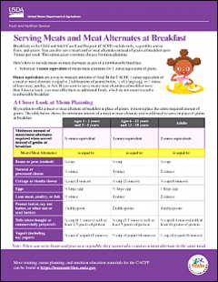
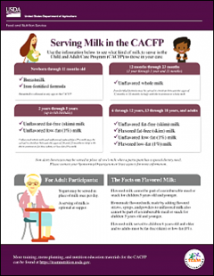
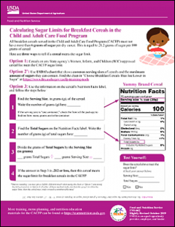
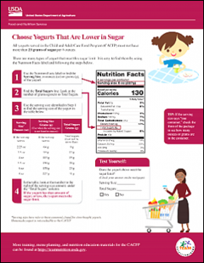
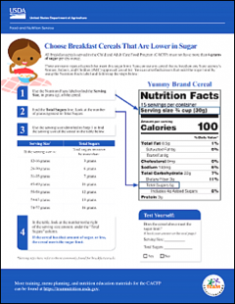
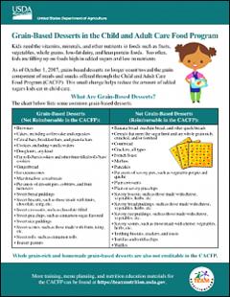
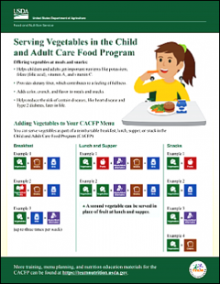
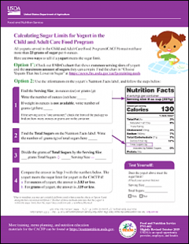
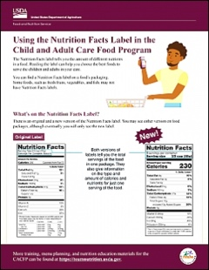
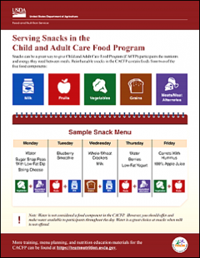
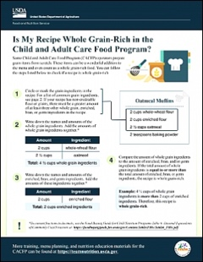
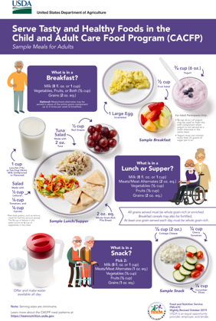
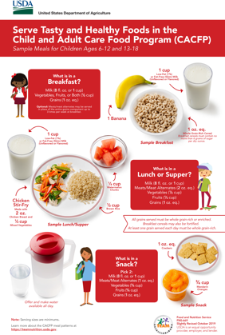
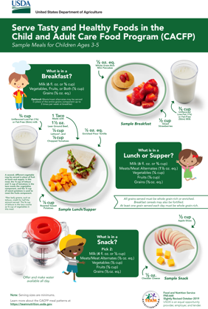
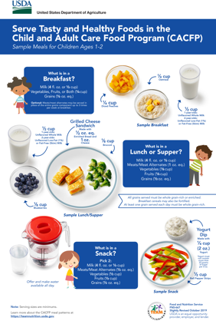
Additional Team Nutrition Resources
fna.usda.gov/teamnutrition
Guidance documents lack the force and effect of law, unless expressly authorized by statute or incorporated into a contract. USDA may not cite, use, or rely on any guidance that is not available through their guidance portal, except to establish historical facts.
Notes:
All Team Nutrition materials are available online from Team Nutrition’s website and are available for free download to anybody who is interested.

Slide 42

Thank you!
fna.usda.gov/teamnutrition
TeamNutrition@usda.gov
USDA is an equal opportunity provider, employer, and lender.
Guidance documents lack the force and effect of law, unless expressly authorized by statute or incorporated into a contract. USDA may not cite, use, or rely on any guidance that is not available through their guidance portal, except to establish historical facts.
Notes:
These training slides were provided by U.S. Department of Agriculture's Team Nutrition. If you would like to learn more about Team Nutrition and additional resources available, please visit the website, subscribe to the e-newsletter, and connect via email at teamnutrition@usda.gov.

