Slide 1
FY 2026 SNAP
Process and Technology Improvement Grants (PTIGs)
June 17, 2026

Slide 2
Webinar Agenda
PTIG Basics
Fiscal Year (FY) 2026 Objective Areas
Review Criteria
Application Submission
Questions

Slide 3
FY 2026 PTIG Purpose
Develop and implement projects that use technology to improve the quality and efficiency of SNAP application and eligibility determination systems.

Slide 4
Eligible Entities
53 State agencies that administer SNAP
State or local governments
Agencies providing health or welfare services
Indian Tribal Organizations (ITOs)
Public health or educational entities
Private non-profit entities
Note: Entities that received a PTIG award in FY24 or FY25 are ineligible to apply.

Slide 5
Award Information
Up to $5 million in FY 2026
Grants awarded through competitive process
No cost sharing or matching required
Anticipated number of awards: Up to 12
Anticipated funding per award: $20,000 – $2,000,000
Anticipated grant project period: September 2026 through September 2029

Slide 6
Funding Restrictions
No pre-award costs
New projects only
No waiving SNAP regulations
Funds are for SNAP’s share of project costs only
No more than 25% of grant funds are for outreach activities

Slide 7
Key Dates
Application due: June 29, 2026, by 11:59 pm EDT on Grants.gov
Grant awards announcement:
September 2026
Project period: September 2026 through September 2029

Slide 8
FY 2026
Funding Objective Areas

Slide 9
FY 2026 PTIG Objective Areas
Modernize SNAP customer service and client communication to improve efficiency, transparency, and accuracy in application processing and eligibility determinations.
Improve administrative infrastructure and day-to-day SNAP operations in processing applications and determining eligibility.
Invest in technology and systems to coordinate application and eligibility determination processes, including verification practices, between SNAP and other Federal, State, and local assistance programs.

Slide 10
Objective One:
Modernize SNAP customer service and client communication.
Proposals will use technology-based tools to improve the customer experience and allow households to manage their cases.
  Examples:
Creating or improving client self-service options;
Improving communication with applicants and participants with electronic notices (eNotices) and text messaging reminders;
Ensuring applications, verification requirements, notices, and other client communications are clear, in plain language, and easy to understand;
Reducing technology-based barriers to improve service delivery; or
Developing and/or enhancing mobile responsive websites, mobile applications, online applications, and online portals.

Slide 11
Objective Two:
Improve administrative infrastructure and day-to-day SNAP operations.
Proposals will employ technology to improve service levels, reduce administrative burden, and accurate and timely case processing, as required by law.
  Examples:
Increasing State call center capacity;
Improving paper document processing using intelligent or optical character recognition (I/OCR), or robotic process automation (RPA) technology;
Developing workload management dashboards or data analysis tools;
Creating a hard-coded or scripted policy chat bot that would give eligibility workers answers to SNAP policy questions;
Enhancing eligibility systems and applications; or
Developing workload management dashboards, data analysis tools, or risk assessment tools.

Slide 12
Objective Three:
Invest in technology and systems to coordinate application and eligibility determination processes.
Proposals will improve administrative efficiency, as allowable by program requirements, when processing combined applications.
  Examples:
Developing combined applications and partnerships across State-operated assistance programs;
Enhancing cross-program enrollment through integrated mobile applications, online portals, and automated technologies for data population;
Improving data sharing and verification between SNAP and other Federal, State, and local assistance programs within the State agency; or
Creating a technology improvement plan to enhance or develop accurate cross-enrollment or administration, as permitted by law.

Slide 13
Bonus Points
Proposals may receive up to nine total bonus points; up to three bonus points will be available for each bonus point area:
Proposals that are particularly data-driven;
Proposals from grantees that have never received a PTIG;
Proposals that approach solutions from a human-centered design (HCD) perspective.

Slide 14
Recap
Purpose:
Develop and implement projects that use technology to improve the quality and efficiency of SNAP application and eligibility determination systems.
Objectives:
Modernize SNAP customer service and client communication.
Improve administrative infrastructure and day-to-day SNAP operations.
Invest in technology and systems to encourage cross-collaboration and cross-enrollment.
Due Date:
Applications must be submitted to www.Grants.gov by June 29, 11:59 pm EDT

Slide 15
Advanced Automation
Federal law and SNAP regulations require that States use employees hired under a merit system of personnel administration to conduct SNAP certification functions. ​
SNAP certification functions include:
Conducting interviews;
Determining households’ eligibility and benefit levels; and
Making changes to participants’ cases that may affect their eligibility and benefits.

Slide 16
Advanced Automation Examples
Type | Description
No-Change Periodic Reports​ | Uses RPA to automatically process no-change periodic reports and create a task for a merit worker to process reports that are incomplete or indicate changes​
Data Population​ | Uses optical character recognition (OCR) or other automation to streamline uploading case information​
Interactive Voice Response​ | Uses pre-recorded messages or text-to-speech technology to engage callers, allowing them to provide and access information without a worker​
Chatbots​ | Uses a scripted bot to respond to general inquiries about case status​
Baby Bot | Uses information from Presumptive Eligibility Determiners in hospitals to populate the case file

Slide 17
Advanced Automation Information
Outline the scope and type of advanced automation your project includes
Questions to consider:
  Does your project include generative AI?
  What level of access would the advanced automation have in your system(s)?
  Are there case identifiers to track when advanced automation is used for a case?

Slide 18
Advanced Automation Resources
Advanced Automation in SNAP Memo
March 2024 Nonmerit Toolkit and Memo
Major Change Resources

Slide 19
Review Criteria

Slide 20
Review Criteria Elements
Project design (35 points)
Impact and evaluation (30 points)
Budget and economic efficiency (20 points)
Organizational experience, staff capability, and management (15 points)
Bonus points (up to 9 points)
Total points: 109
Note: Review criteria is based on application content as outlined in the RFA. For more information, please see the RFA posted on Grants.gov.

Slide 21
Review Criteria:
Project Design
The proposal clearly defines the problem, the solution, the intended impact and outcomes, and demonstrates that the solution is innovative.
The Project Design section should include:
  Problem Analysis
  Implementation
  Innovative Aspect(s)
  Sustainability
  Letters of Commitment or Endorsement

Slide 22
Special Instructions:
Letter of Commitment
A Letter of Commitment is required if the grant proposal is from a State agency working in partnership with another organization(s).
The letter(s) of commitment must describe:
The organization’s role in the project;
The amount of time the partner organization intends to commit to the project; and
An attestation that it will cooperate with the grant applicant in implementing the project.

Slide 23
Special Instructions:
Letter of Endorsement
Grant proposals from entities other than a State agency must demonstrate that the State SNAP agency strongly endorses and/or is involved in the proposed project through a Letter of Endorsement.
The State agency’s letter of endorsement must:
Explain that the State agency is aware of the projected impact on its eligibility system and is supportive of the project;
Acknowledge whether the project creates any additional work for the State agency and identify the State agency’s capacity to address this work; and
Describe how the project will support the State’s current or planned technology and/or business process improvement efforts and priorities.

Slide 24
Review Criteria:
Impact & Evaluation
The proposal must:
Clearly quantify the proposed project’s impact on the SNAP application and eligibility determination processes listed in the RFA;
Provide measurable evidence that the proposed changes will benefit the applicant, recipient, or caseworkers; and
Identify how the proposed project will impact one or more of the following aspects of SNAP and propose how to evaluate its impact:

Slide 25
Review Criteria:
Impact & Evaluation cont.
All proposals must include a comprehensive evaluation process that:
  Is specific and data-driven;
  Measures if the problem identified is addressed by the proposed project;
  Identifies how the applicant proposes to measure the outcomes of the project;
  Details who will measure progress towards the goal of the project;
  Explains what criteria will be evaluated and how those criteria will be evaluated; and
  Tracks activities and indicators using the Activities Tracker included in the RFA.

Slide 26
Review Criteria:
Activities tracker
Maps proposed activities and indicators of success to the Objective(s) you choose.
Objective #2 | Improve administrative infrastructure and day-to-day SNAP operations in processing applications and determining eligibility, including by employing technology to improve service levels, and accurate and timely case processing, as required by law.
Activity 1 | Implement IVR system (System Build)
Indicator 1.1 | Number of phases (or percent) of implementation completed.
Indicator 1.2 | Test Execution Status: Progress of test execution against the schedule.
Indicator 1.3 | Defect Metrics: Number of defects identified, severity, and resolution status.
Activity 2 | Data Analysis Post-Implementation of IVR (Demonstrate Impact).
Indicator 2.1 | Data collection and analysis of call wait time.
Indicator 2.2 | Data collection and analysis of calls abandoned.
Indicator 2.3 | Data collection and analysis of dropped calls.

Slide 27
Review Criteria:
Budget Appropriateness and Economic Efficiency
Budgets must include:
All required budget forms;
Line-item budget narrative, formatted in a table:
  How funds will be spent, by whom, and for what purpose?
  Narrative should discuss how costs were determined and how they relate to project goals.
Budget estimates should be justified and demonstrate that project costs are comparable to industry standards.
Budget narrative should provide evidence that the project is cost-effective.
Refer to RFA for what to include.

Slide 28
Review Criteria:
Budget Appropriateness and Economic Efficiency cont.
Cost Allocation:
If necessary, identify programs other than SNAP that may benefit from the project and allocate project costs across the benefiting programs.
Sub-Project Costs:
If necessary, provide a funding breakdown for each sub-project identified in the application.
Contractual and Consultant Costs:
If necessary, applicants who hire a consultant or contract work out must provide information contained on page 17 of the RFA.
Budget Table as Appendix:
The budget narrative table must also be attached as a spreadsheet (e.g., Microsoft Excel, .csv, etc.) to the application as an appendix with all costs listed and which aligns to the categories on the SF-424.

Slide 29
Review Criteria:
Budget Appropriateness and Economic Efficiency cont. 2
If applicable or desired, budgets may include:
Approved Negotiated Indirect Cost Rate Agreement for indirect costs
Tiered budgets and the corresponding narrative discussing different possible funding levels
501(c)(3) letter for non-profits

Slide 30
Review Criteria:
Budget Checklist
Does the project and budget meet the bona fide needs of the RFA?
Is the budget summary included?
  Does it agree with the calculations shown on the OMB budget form (SF-424A)?
  Is the budget in line with the project description?
Are budget figures consistent across displays and narratives?
Did you use the Budget Checklist found in Appendix B of the RFA?
Did you upload the budget narrative as a separate spreadsheet?

Slide 31
Review Criteria:
Organizational Experience, Staff Capability and Management
The proposal must:
Describe a plan for effective and consistent oversight by qualified project managers;
Include the organizational chart for the project;
Include an internal communications plan, and external plan if necessary; and
Include resumes and proposed project job descriptions for all involved employees.

Slide 32
Review Criteria:
Organizational Experience, Staff Capability and Management cont.
The proposal must also:
Identify key project staff and outline the amount of time they will commit to the project; and
Delineate how all data and client personally identifiable information (PII) would be protected in accordance with Section 11(e)(8) of the Food and Nutrition Act of 2008, Federal regulations at 7 CFR 272.1(c), and the Privacy Act of 1974.

Slide 33
Application Submission

Slide 34
Pre-Application Requirements
  Applicants must have a current Unique Entity ID (UEI) number generated by SAM.gov.
  New entities can get their UEI and register in SAM by selecting the purpose of the registration and providing the requested information.
  Existing entities can find their UEI on the SAM.gov website.

Slide 35
Pre-Application Requirements cont.
Enter the following information to get a Unique Entity ID:
    Legal Business Name
    Physical Address (PO boxes may not be used)
    Date of Incorporation
    State of Incorporation
  It may take 7-10 business days to register, complete migration of permissions, or renew an entity record.
  We strongly encourage applicants to begin the process at least 3 weeks before the due date, June 29.

Slide 36
Grants.gov Information
Follow the guidance provided in the grants.gov FAQ page
Limit file attachment name lengths
  File attachment names longer than approximately 50 characters can cause problems processing packages
Special Characters are not supported
  Special characters example: &,–,*,.,%,/,#,’, -
Contact the Grants.gov help desk with any submission issues
  1-800-518-4726
  Support@grants.gov

Slide 37
Grants.gov Required Forms
All applicants:
SF-424 Family:
  Application for Federal Assistance (SF-424)
  Budget Information and Instruction Form (SF-424A)
  Assurance for Non-Construction Programs (SF-424B)
SF-LLL (Disclosure of Lobbying Activities)
FNS-906 – Grant Program Accounting System & Financial Capability Questionnaire
If applicable:
Negotiated Indirect Cost Rate Agreement
AD-3030 – Representations Regarding Felony Conviction and Tax Delinquent Status for Corporate Applicants
Forms can be found at: grants.gov/forms

Slide 38
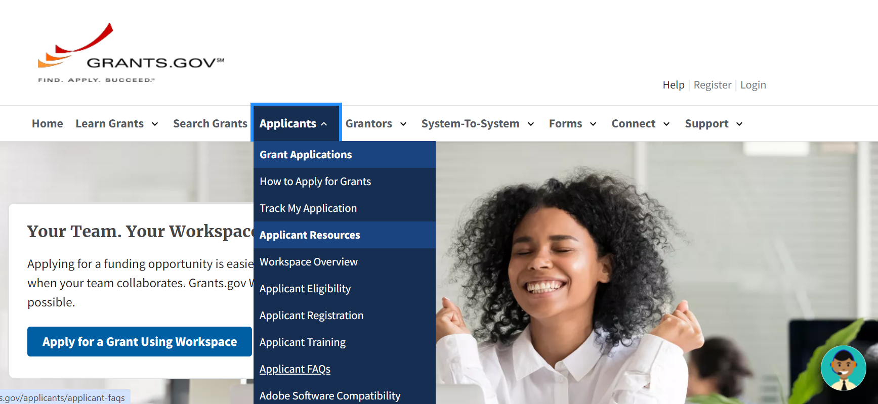
Grants.gov Help

Slide 39
Additional Information

Slide 40
Reporting Requirements
  An example FNS-908 form is in Appendix C of the RFA for reference
  Training on the form will be provided to grantees after the PTIG grants are awarded
  Progress AND financial reports due on a quarterly basis

Slide 41
Quick Reference Links
PTIG Landing Page: fns.usda.gov/snap/ptig
Submit your completed application to Grants.gov by June 29, 2026, 11:59 pm EDT.

Slide 42
Questions?
Key Contacts
Dawn Addison – Grants Officer
Dawn.Addison@usda.gov
PTIG Inbox
SM.fn.SNAP-PDB-PTIG@usda.gov

